Slide 1
An Analysis of Twitter Usage Among Startups in Europe
Sergej Lugović Polytechnic of Zagreb Vrbik 8, Zagreb, Croatia lugovicsergej@gmail.com
Wasim Ahmed Health Informatics Research Group, Information School, University of Sheffield, Sheffield, UK Wahmed1@sheffield.ac.uk

Slide 2
Twitter usage for the purpose of entrepreneurial activities
marketing activities
medium of communication
support the whole process from opportunity recognition to bringing those opportunities to life
global reach and low cost
support promotion and branding since
community interactions
observe the competition and industry
better understanding and engaging with customers (including customer support)
a tool integrated into product development, marketing communication, and recruitment

Slide 3
Social Media Platforms
316 million monthly active users and than 500 million tweets per day
93 percent declare that they employ social media in their marketing strategy,
Facebook is top-rated (92%), followed by Twitter (84%) and LinkedIn (71%)
there’s a statistically significant relationship between a firm’s innovativeness and the adoption of Twitter - Wamba & Carter (2013),

Slide 4
Investor Relations
IR is a strategic management responsibility that’s integrated into
finance,
communication,
marketing, and
law compliance
to enable two-way communications between company, the financial community, and other stakeholders
It contributes to a company’s security to achieve fair valuation

Slide 5
Investor Relations
investors match the take-up on social media by companies, and social media has the potential to move financial markets
63 percent of finance professionals (including brokers and heads of trading desks) believe that valuation of individual stocks can directly link to public sentiment contained in social media channels
63 percent of 800 publicly traded companies use Twitter for investor-related activities
three out of five financial bloggers use Twitter as their primary news source
Twitter is the most widely used channel for IR, 72 percent out of 890 companies surveyed used Twitter to communicate investment materials in 2013
investors viewed financial blogs, along with LinkedIn and Twitter, as the most valuable social media resources

Slide 6
“startup” as a phenomenon
Venture capital funds in the EU
mentioned frequently within the media, within political speeches, and European commission programs
there’s still no clear definition of what a startup is

Slide 7
Two Side of the Coin
Ewing Marion Kauffman Foundation (Morelix et al., 2015) stating that “Startup businesses here are defined as employer firms less than one year old employing at least one person besides the owner.”
definition by NESTA (Dee at al., 2015) that defines startups as “[A] young, innovative, growth–oriented business (employees/revenue/customers) in search of a sustainable and scalable business model.”
NESTA, the emphasis is on defining startups as young companies. They differ from overall SMEs and need to develop different policies to support young companies and different ones to support small firms.

Slide 8
research into entrepreneurial behavior
there’s no consensus on what a startup is and what it does.
Instead of seeking a definition, it’s necessary to look at what those companies are doing
not “What is this?” but instead, “What does it do?”
It doesn’t consider objects; rather, it considers the ways of behaving (Ashby, 1957).
companies actually do is the result of their founders’ action.

Slide 9
This paper examines the correlation of the Twitter usage of startup founders across the EU with the total country investment in startups in order to ascertain the extent to which we can predict how the startups will behave in the future.

Slide 10
Methodology
In total, the authors retrieved 50,433 founders from 29 EU countries (including Norway), with the assistance of four freelance workers hired through the Upwork platform (Upwork.com, n.d.) from F6S.com, which has more than 110,000 companies in the database and 2 million unique visitors a month (f6s.com, 2015)
There were more records in total; however, some founders related to more than one company, so the data set had to be de-duped (i.e., the removal of duplicates).
Registering founders had the option to submit a company Twitter account and personal Twitter account. For the purpose of this research, the authors focused on the personal Twitter accounts the founders submitted.
After the identifying the Twitter accounts, the authors retrieved data from the accounts, in particular, the date the founders joined Twitter, how many tweets they posted, how many accounts they were following, and how many followers they had, in total 15,192 accounts.
We also classified whether an account was private for the purpose of this study, and this was inferred from whether the founder submitted it as a private Twitter account.
The authors retrieved data from twenty-nine countries from the EU, including Norway.

Slide 11
Methodology
In parallel, the analytical company Funderbeam (2015) provided the financial data addressing EU-wide startup investments.
This financial data broke down into investment per capital per country and total amount of investment in the startup ecosystem per particular country.
Further, we selected Twitter accounts that had more than one hundred tweets and then more than one hundred followers.
Those accounts, when filtered, were entered into the retrieval system Twitter Arching Google Sheets (TAGS) (Hawksey, 2013), which the researchers set to retrieve data on daily basis from those accounts.
In total, there are 9,696 startup founders that have more than one hundred tweets and more than one hundred followers, and the accounts went into the TAGS system. The data retrieval period was from July 15, 2015 to ...

Slide 12
Hypotheses
H1 time spent on Twitter
H2 number of tweets of total country startup founders
H3 number of followers of total country startup founders
H4 Number of startup founders with more than one hundred tweets and followers per country
H5 Percentage of total number of startup founders in the F6S.com database
will be a statistically significant positive correlation with
a) total investment in that country and
b) investment per capita.

Slide 13
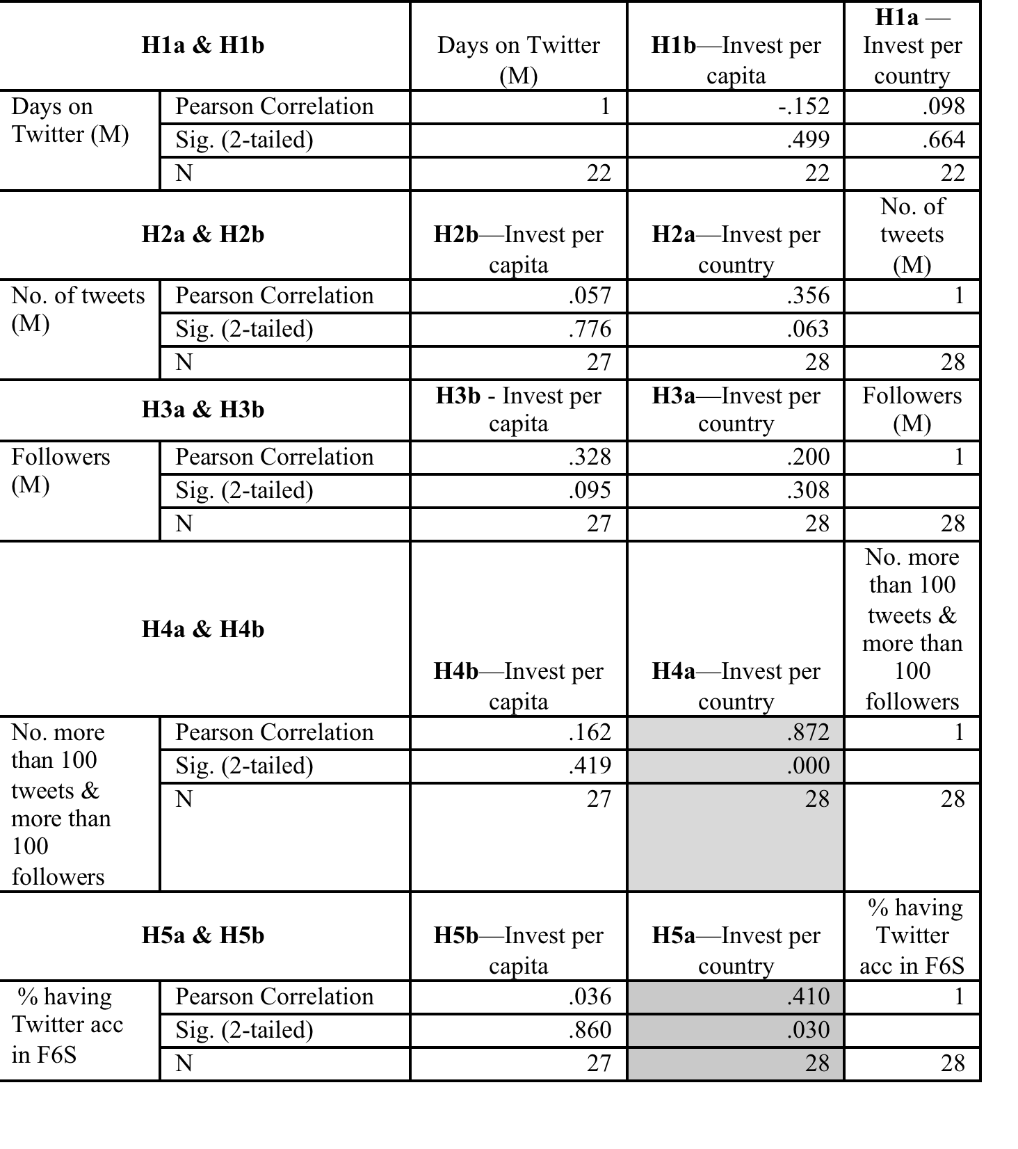

Slide 14
DISCUSSION
Rejection of other hypotheses could be interpreted that the average quantity of the tweets, followers, those the founders followed, and period spent on Twitter per country do not have an impact on the size of the investment startups receive and distribution of investment per capita.
Therefore, it isn’t about how much is tweeted, however it could relate to the country level of Twitteracy (Greenhow & Gleason, 2012).

Slide 15
Bernstein, Korteweg, & Laws (2015) showed that average investors when looking for information about startups strongly respond to the founding team but not to firm traction or lead investors.
(Tata et al., 2015) used data from Twitter accounts of startup founders and analyzed the content of their tweets in relation to funding raised
They found relations between tweets content and startup performance, including funding raised.
The results demonstrate that high past focus, low future focus, high collective self-categorization, and lower level construals can associate with better performance.
Findings from this research, in particular, collective self-categorization, align with our findings, showing that size of the country ecosystem of startup founders is in positive correlation with country investment

Slide 16
The stronger the country’s Twitter community is the more the country receives in funding
Lack of significant correlation between number of tweets, followers/following, and days spent on Twitter lead the authors to question relevance of the content created and distributed over Twitter to the investors.
The hypotheses presented in this paper are put forward on a macro level (correlating within EU countries), and a micro level (individual founders’ accounts) analysis has to be explored and analyzed in the next phase of the research

Slide 17
Future Research
dynamics of the founders’ Twitter activities could correlate with startup performance
sentiment analysis, network analysis, and the correlation of Twitter data with the companies’ income.
correlation with Twitter data with another social media channel, for example, Facebook or LinkedIn, or data such as the companies’ Wikipedia pages and the number of visitors to the websites of the startups.
use a variety of databases; however, this may not be feasible since the numbers gathered could become difficult to manage
the research continues to collect data on a continuing basis from the 9,696 startup founders (Twitter accounts), which could provide insight into different aspects of startup as a phenomenon.

Slide 18
CONCLUSION
The findings demonstrate that it’s possible to achieve great insight into the behavior of an object of interest by using indirect observation, in this instance observing Twitter data indirectly.
However, to do so, the analysis has to dig deeper into the large amount of unstructured data processed by using advanced techniques.

