Slide 1
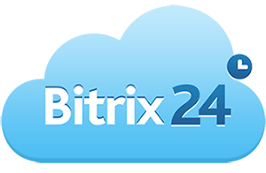
Bitrix24
Marta Alić, prof.
University of Applied Sciences, Zagreb
integrated business-information system for sales process support

Slide 2
Introduction
Why integrated business-information system?
With the development of information technology, its application in the organization of the business process has risen.
In order to manage and keep track with shifting modern markets companies and organizations need to be more agile in keeping track of new trends.
By implementing complex, integrated business and information systems in their structures they can automatize their processes, orchestrate them more efficiently, improve internal and external communication.
This presentation gives the overview of Bitrix24 system basic functions as a cloud network solution that integrates the customer relationship management (CRM) with the information systems of the entire company.

Slide 3
Bitrix24 is an intranet developed in cloud environment that connects multiple information systems of various business processes in the company:
Customer Relationship Management
Project Management
HR (and internal administration)
Document Management
Accounting

Slide 4
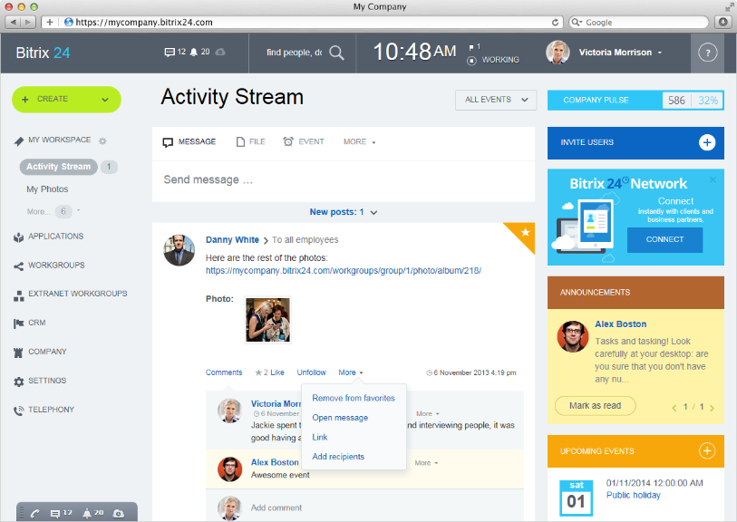
Social networking
Bitrix24 has an innovative approach to system architecture using principles of social networking to connect all mentioned functionalities:
Activity stream is a basic form of interaction among employees.
Notes:
Every employee can see the latest news and track changes that took place within the company and interact with them.
Through this interface one can easily schedule an event, organize a poll, upload files and/or make a post as a part of a project management IS. Functionalities of requests in internal administration (such as business trip approval, leave approval, purchase requests, etc.) can also be made through this interface and can be served as an HR functionality.

Slide 5
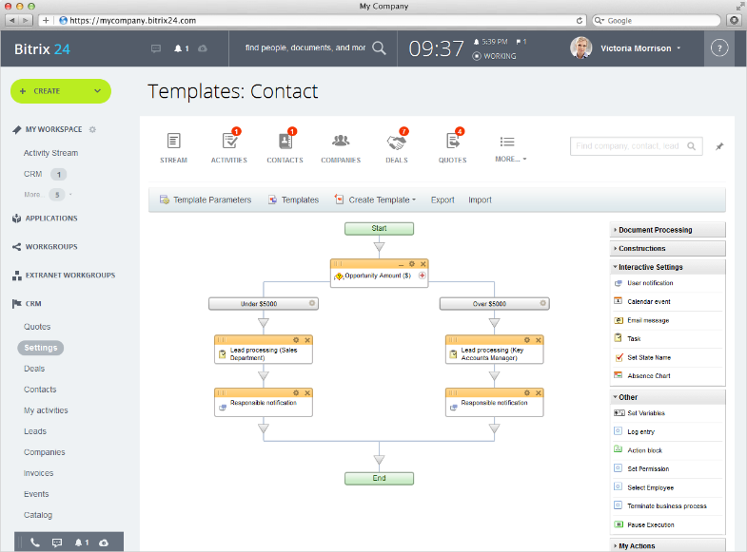
CRM
The base system is a CRM (Customer Relationship Management) that connects business processes of marketing and sales in order to:
support collaboration and communication with customers, partners and suppliers,
allow the construction of the employee communication and collaboration along the organizational structure of the company and
support business process automation through default workflows or customized ones

Slide 6
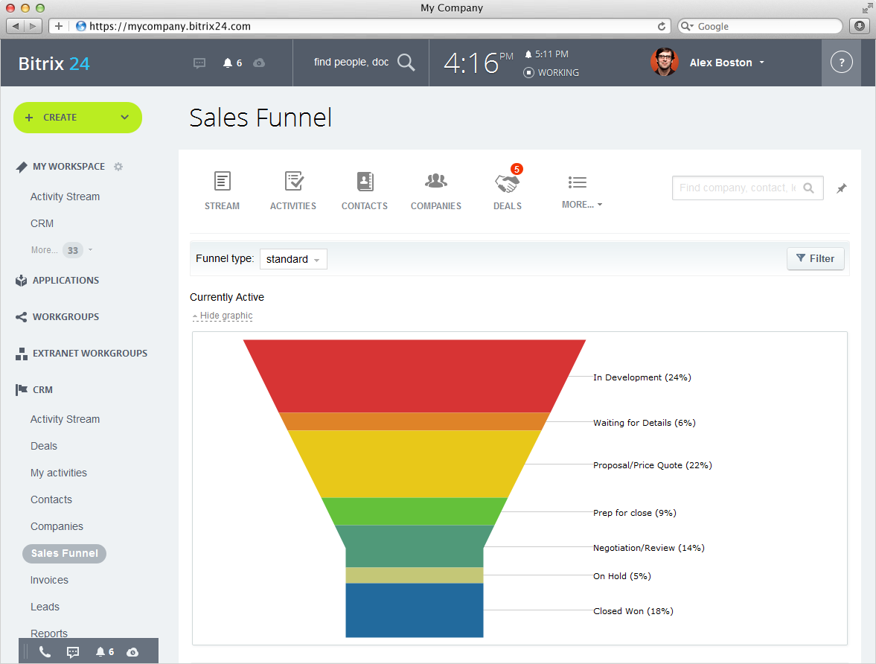
CRM
Lead Management
Built on the lead management methodology of sales funnel system supports actions for segmentation of prospect sales (leads) depending on its status or other parameters
At the end of a process, leads can be qualified as junk or quality leads that are converted to deals.
Notes:
Lead is a CRM object that represents a buyer's interest in a product or service and it is usually a result of the organization's marketing strategy and actions through various sales channels (website, social networks, direct sales channels, etc.). By passing through system leads are being qualified and prioritized according to their level of the realization possibility. At the end of a process, leads can be qualified as junk or quality leads. First ones are then being removed from system or sent back for remarketing, while second ones are being converted to deal.
Deals are system objects of sales business processes that contain the interaction with a buyer pertaining to a transaction. Deals proceed through the system by a number of customizable statuses given by the system or customized by a workflow and they result with a closed sale (won or lost). At this stage of the sales process, system offers the possibility of quote generation, accompanied with referring invoice, as two new objects in system, connected with accounting operations IS and DMS.

Slide 7
CRM
Deals
Deals are system objects of sales business processes that contain the interaction with a buyer pertaining to a transaction (negotiation process).
At the end of process deals can be won or lost

Slide 8
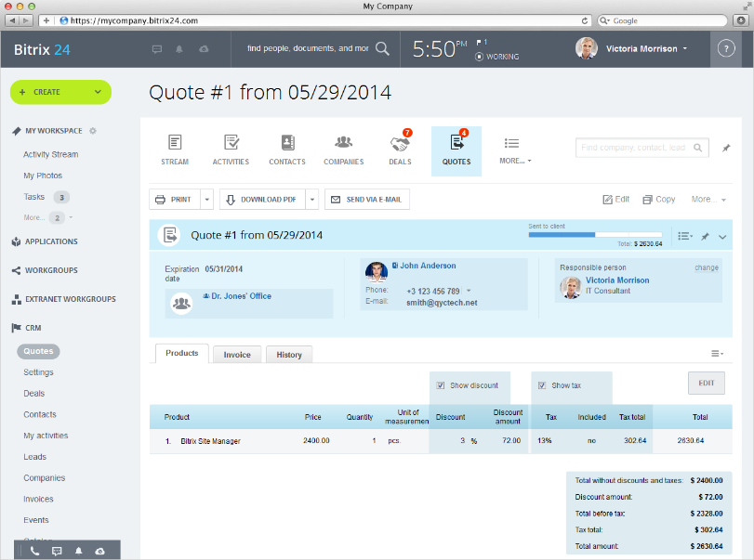
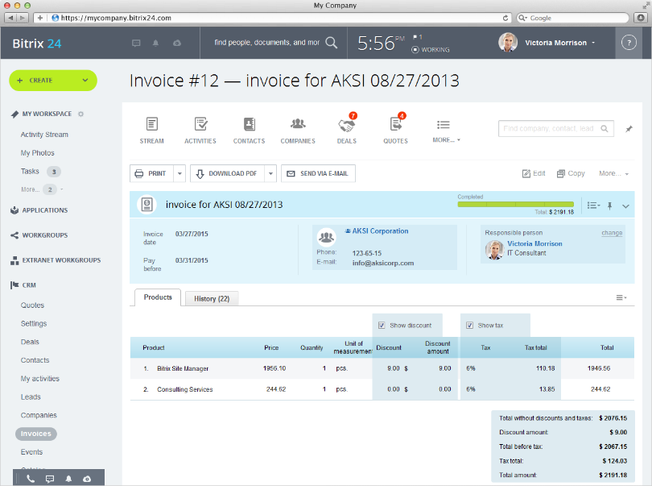
CRM
Quote/Invoice
System offers the possibility of quote generation, accompanied with referring invoice, as two objects in system, connected with accounting operations IS and document/records management (DMS).

Slide 9
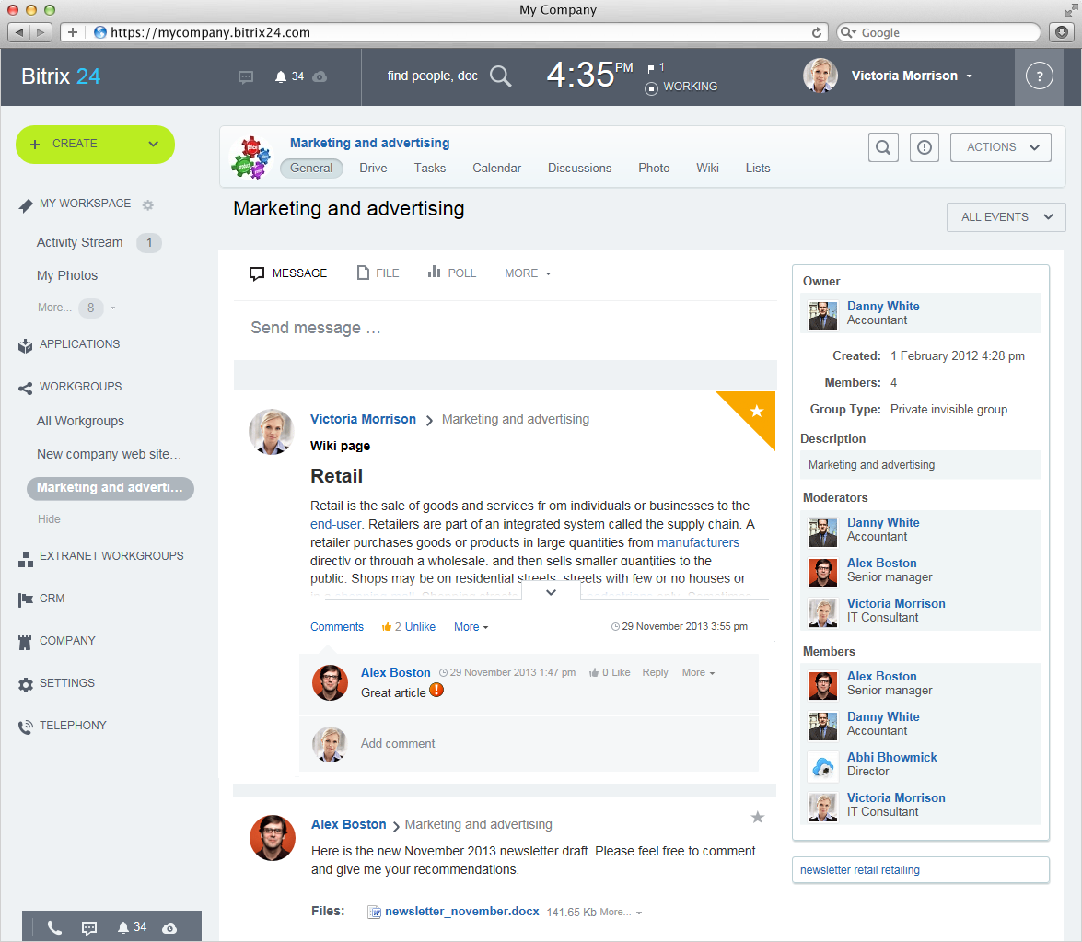
Project and task management
Keeping social network functionality and lead management stucture in basis of system, Bitrix 24 suggests clear organizational structure of departments in internal communication systems
By using workgroups , every department unit can have own sub-system network where employees within have every functionality of the entire system and where all collaboration and work is documented on activity feeds

Slide 10
Document and Records Management
Bitrix24 comes with three types of Drives:
My Drive: a personal file storage to which colleagues do not have access to
Group Drive: contains files uploaded inside a particular workgroup and all participants of that workgroup have access to it
Company Drive: contains all files that company wants to make available to all employees
Users can collaborate on documents directly on Activity Stream using Google Docs and MS Office Online.
Each document stored in Bitrix24 has a Change Log and it is easily indexed and searched.
Notes:
When a new version of the document is loaded, the previous is not deleted, but is stored in order to be available at all times and records history provides information about the time when the version created and the user who created it.

Slide 11
Product catalog
Bitrix24 system offers product catalog for managing sales processes more clearly.
Products are easily connected with lead and deal objects in the system, giving more detailed overview of realized sales
Products can be categorized in sections and have a range of settings options in the system (tax rates, units of measure, currency) as well as customizing options for fields and attributes.

Slide 12
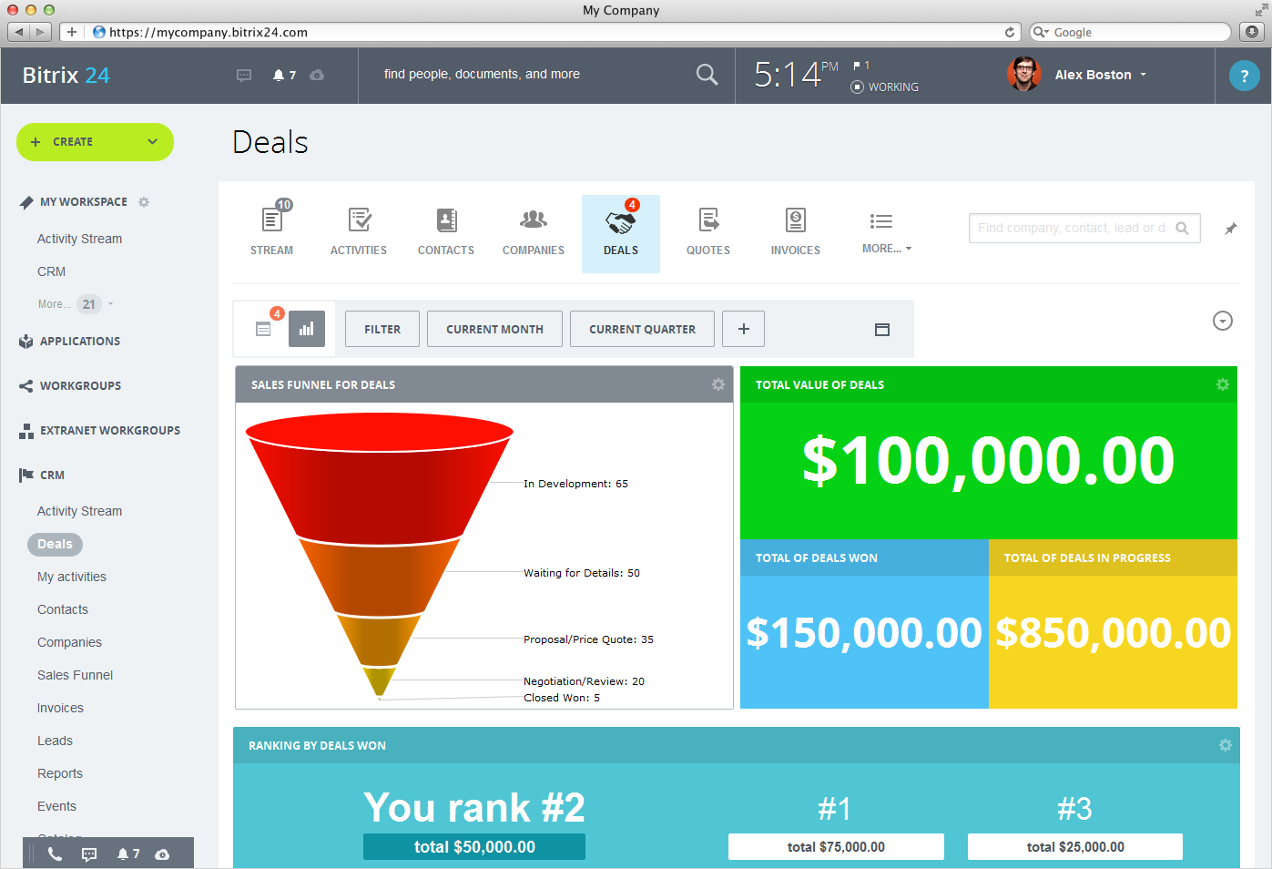
Management support
One of the major benefits of CRM system implementation is its support to the management.
CRMs are often used for planning and forecasting of future sales activities.
Bitrix24 offers a detailed statistical report of sales business processes by individual components - objects, their status and the persons responsible.
Notes:
There are also embedded reports by products, activities and invoices sent and revenue made. Bitrix 24 in its purpose is not analytical system and in-depth analyzes and forecasts cannot be made within the system, so the segmented data are used primarily for optimization of business processes and as raw data for redistribution.

Slide 13
Conclusion
By introducing elements of social networks in the communication and collaboration processes, Bitrix24 system sets different approach to business process organization.
Although primarily designed to support the sales processes and customer relations, the system sets wider functionalities of business management, incorporating information systems of document management and project management, human resources, accounting and product catalog functionalities; providing automatization of related activities.

Slide 14

Thank you.

Slide 15
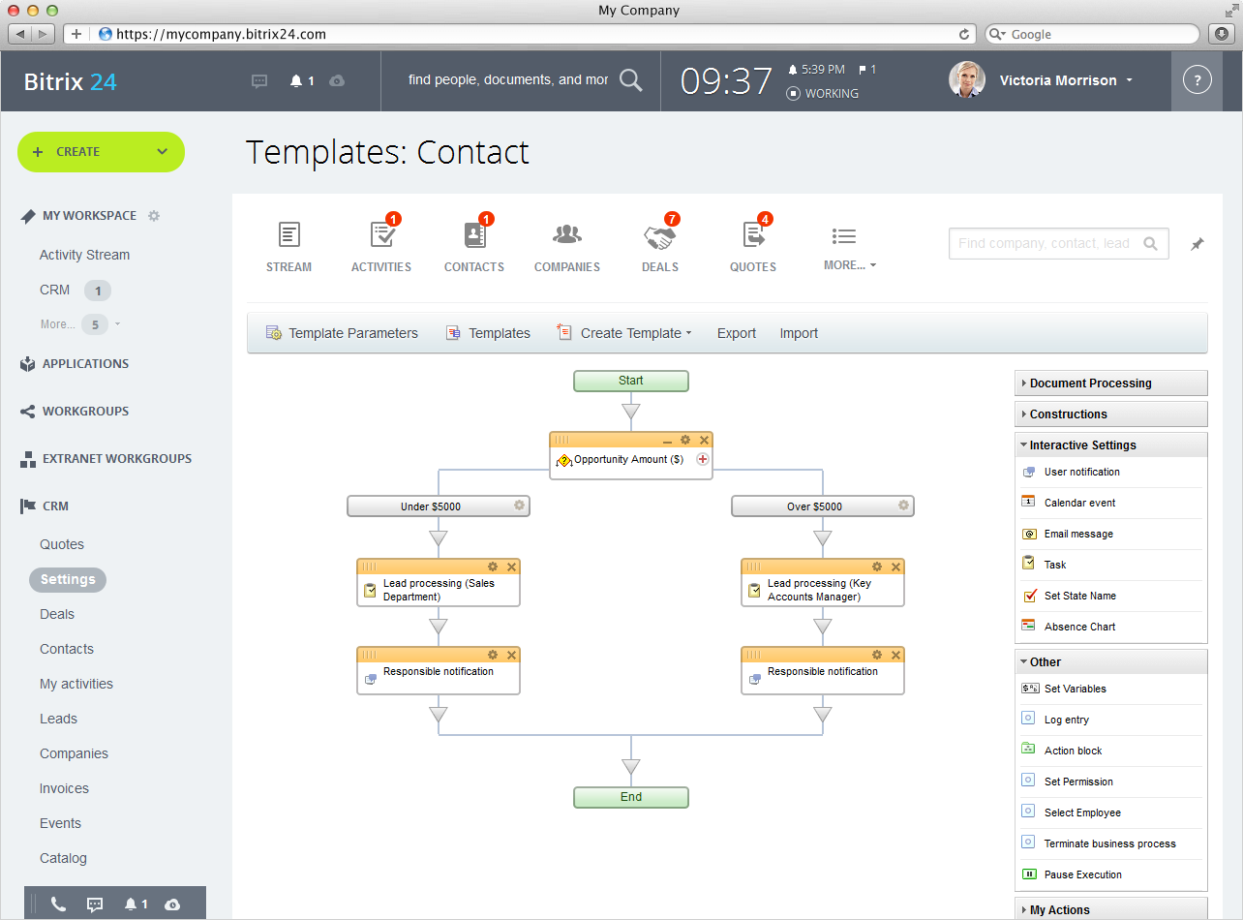

Slide 16


Slide 17
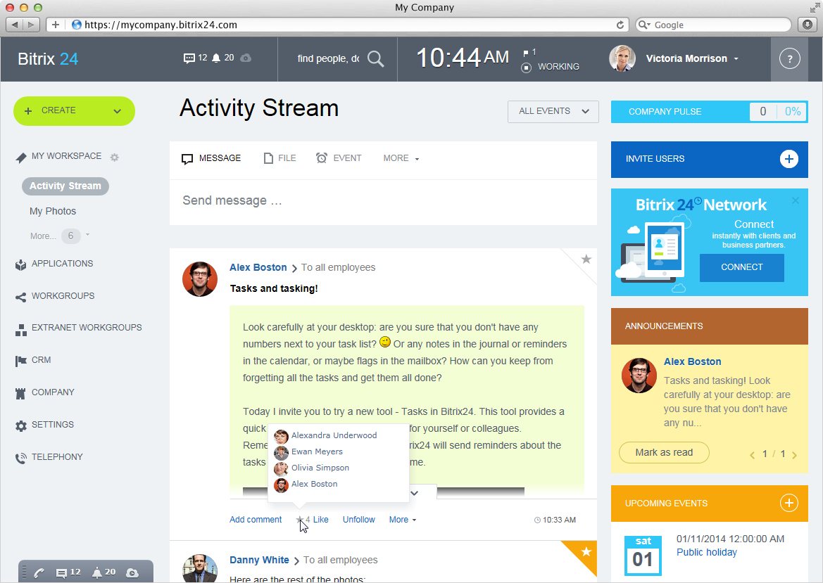

Slide 18
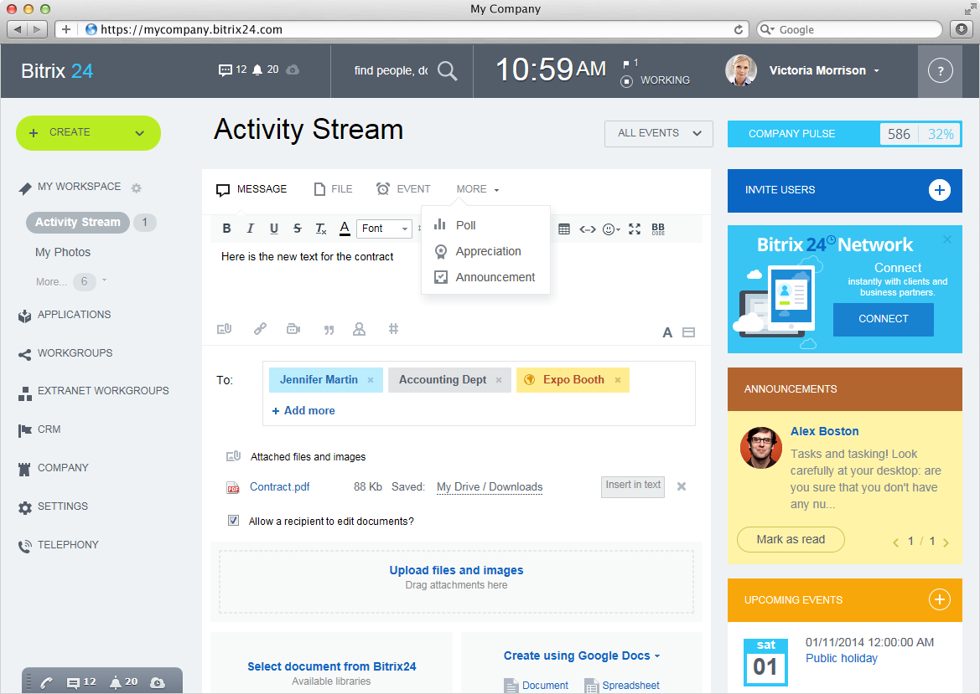

Slide 19
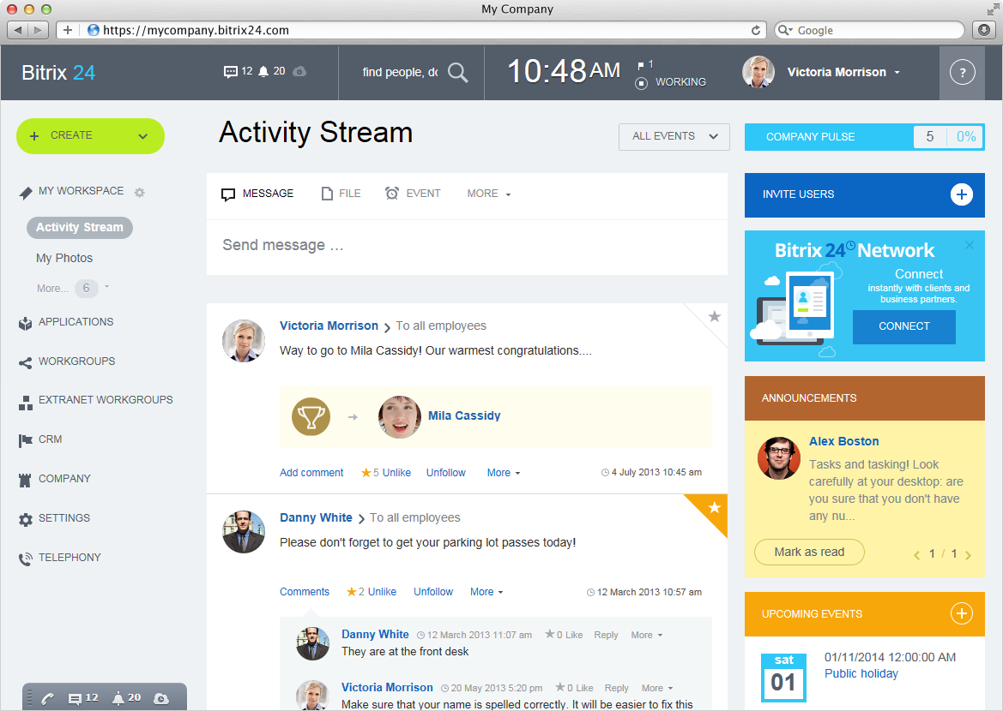

Slide 20
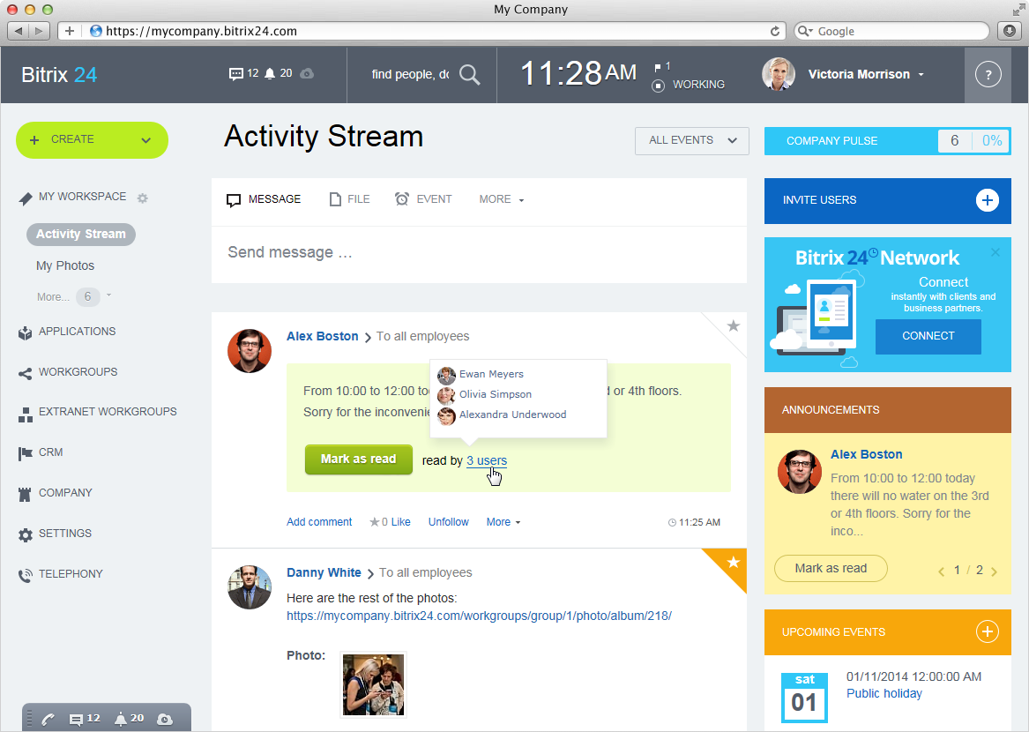

Slide 21
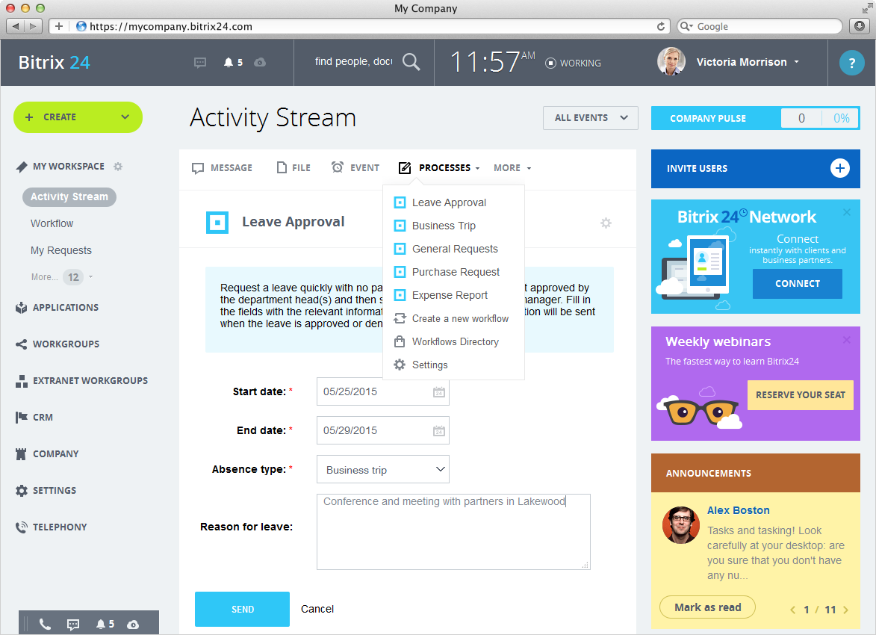

Slide 23


Slide 24
