Slide 1

PIQL PRESERVATION SYSTEM
Physically present
– future preserved
Zagreb | November 11th 2015

Slide 2
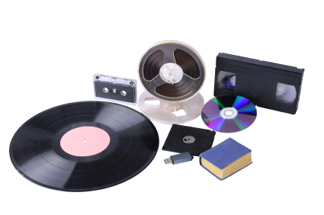
Ensuring long-term access is a constant struggle
No migration-free archiving is possible
Data migration could cause data loss
Immutability of data is hard to guarantee
Obsolete technology
  Outdated file formats
  Security and privacy threats
Notes:
Google: 3,5% ihrer Festplatten crashen pro Jahr. Hersteller geben eine Festplattenlaufzeit von 5 Jahren an.

Slide 3
Prepare yourself for a huge data growth...
From now until 2020, the digital universe will about double every two years.
Source: IDC, Digital Universe Study, 2012

Slide 4
...and expect your costs to escalate
“…migration applies to the entire collection repetitively: each and every single object in the digital archive has to be converted, again and again.
This means that the bigger the archive gets, the more expensive migration will be.”
Source: National Library of Netherlands,
«A cost comparison between emulation and migration»
Cost of Migration
Archive of 1 000 000 digital files

Slide 5
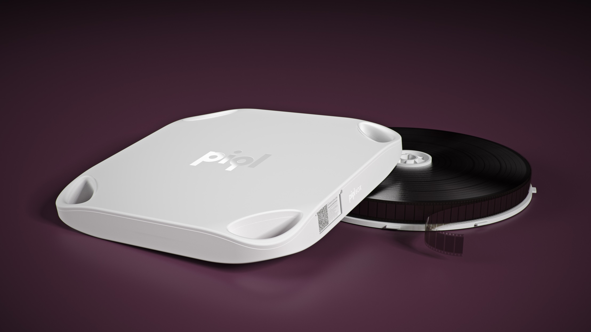
Combining the preservation qualities of film with the user-friendliness of digital technologies

Slide 6

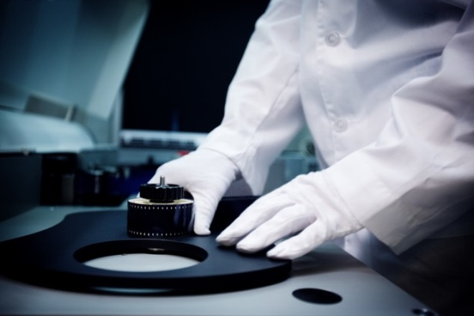
How it works…

Slide 7
How we archive
Example „Treaty“
Optical storage > 20 pages/frame
86 pages >> ca. 4,9MB pdf
2MB per/frame > 2 frames

Slide 8



Slide 9
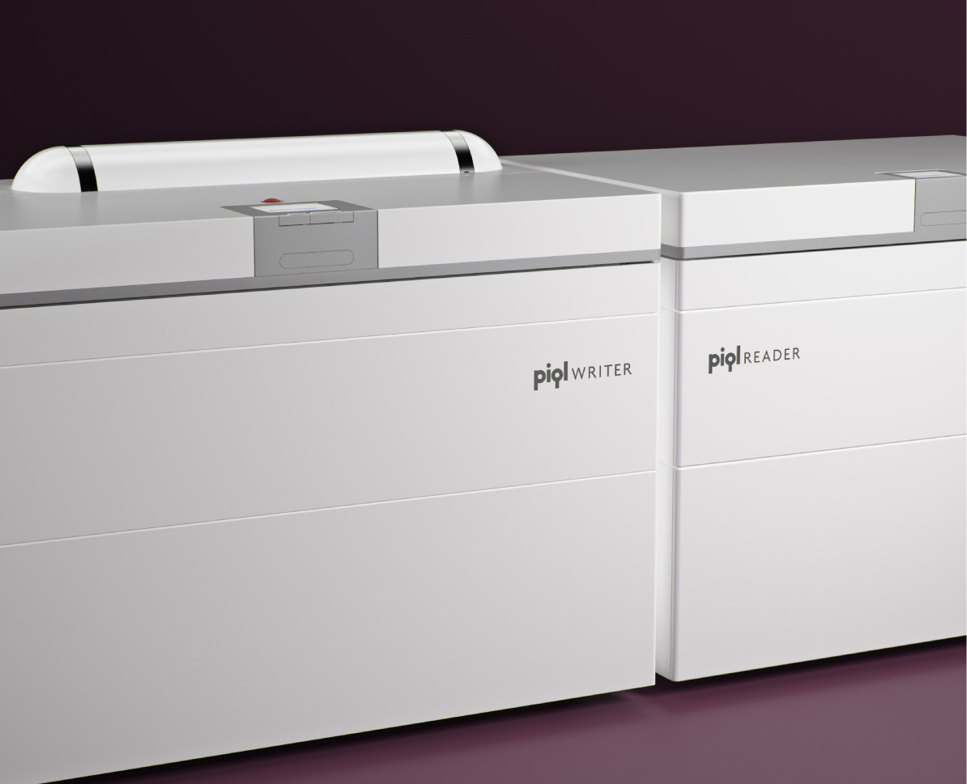

Slide 10

What can be archived
Without limitation every file
format and data structure can be
archived on the supporting medium

Slide 11






A holistic approach to digital preservation
MIGRATION-FREE
Avoid the risk of data loss, save time and get a predictable long-term cost.
UNALTERABLE
By using a true WORM medium, we make it impossible to modify or delete recorded data.
FLEXIBLE
We can store your data in computer readable digital format or in human readable text or images.
SEARCHABLE
Your data is fully searchable, so you’ll always find what you need.
PERMANENT
Our film and box are tested to keep your data intact for 500 years.
FUTURE-PROOF
We ensure data retrieval is possible independent of future access to specific technology or vendors.

Slide 12
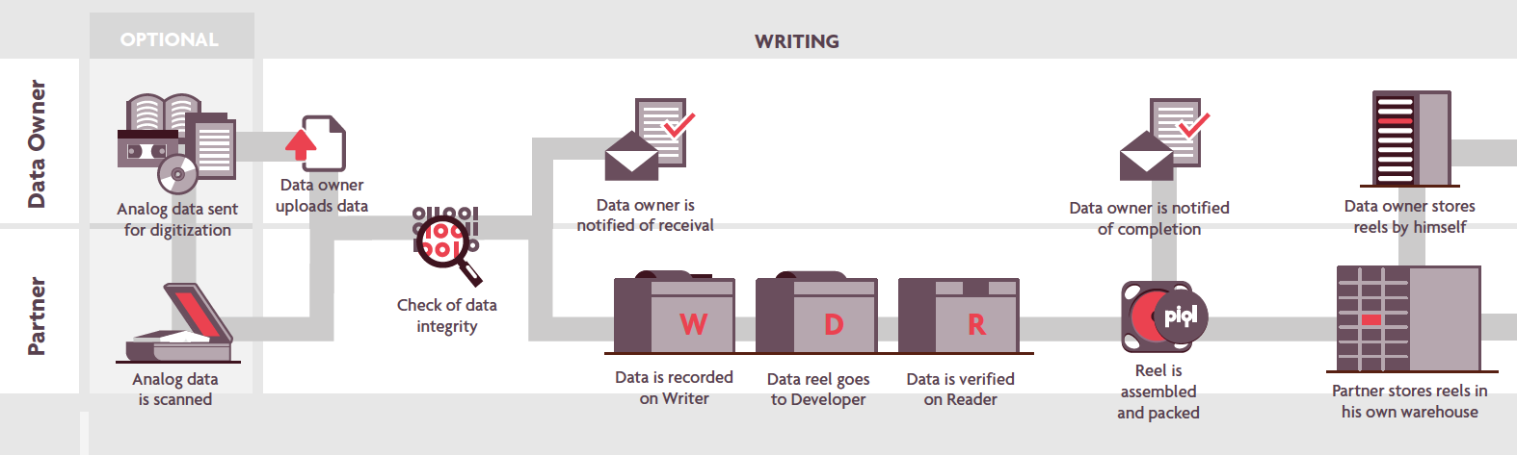
Service Workflow

Slide 13

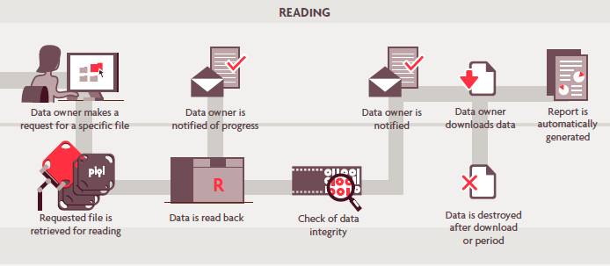
Workflow
Data Retrieval
Online Metadata search
Online data retrieval
Physical media delivery (optional)
SLA – Delivery time (optional)
Electronically delivered or Physical media (optional)
Online data retrieval – easy accessibility

Slide 14

Main conclusions
Piql is more cost-efficient than LTO and HDD when data is preserved for longer than 10 years
Cost savings increase with time
For certain scenarios, break-even occurs for a period as short as 4-6 years
Main cost drivers for LTO and HDD are migration and service costs.

Slide 15
Comparison of technologies
 | HDD | LTO-6 | piqlFilm
Capacity per unit | 4 TB | 3.2 TB | 100 GB
Speed to write | 80 MB/s | 160 MB/s | 44 MB/s
Access time | Instant | Hour | Hour
Expected life time | 3-5 years | 6-7 years | 500 years
Migration requirement | Yes | Yes | No
Risk of data loss | Yes | Yes | No
Self-contained | No | No | Yes
Estimated cost per GB/year*
25 years storage | 2.4 € | 1.23 € | 0.35 €
10 year storage | 2.4 € | 1.37 € | 0.77 €
* Based on 1000 GB existing data
Sources: Piql cost comparison model 0.7
Gartner: IT Key Metrics Data 2015

Slide 16
Scenario 1TB preserved for 25 years
Piql is more cost efficient than LTO and HDD after 5-6 years
Scenario:
1000 GB of existing data, preserved for 25 years over 3 generations LTO
Stored at own premises with possibility for access, but no data retrieval performed

Slide 17
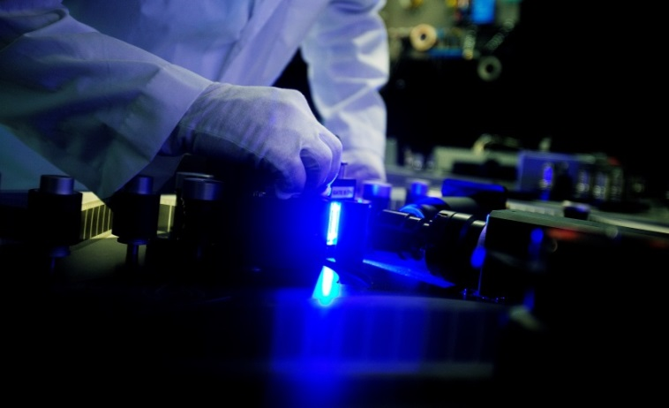













The result of years of research
  European research project involving companies and institutions globally renowned within their fields
  In-Vision is core-development-partner and exclusive technology partner for the future
  R&D investment of € 20 Mio.
  Supported by the EU and Norway
Notes:
----- Besprechungsnotizen (22.05.14 10:56) -----
Intellectual Property der In-Vision => wir nicht austauschbar

Slide 18


Your ultimate
digital insurance
Preservation Services for your valuable digital data
Ing. Alexander Rych, BA
In-Vision Digital Imaging Optics GmbH
Industriestraße 9
2353 Guntramsdorf - Vienna
AUSTRIA
T +43 664 832 50 79
E rych@piql.at

