Slide 1
INFuture2015
Zagreb, 11-13 November 2015
Long-term Preservation
of Longitudinal Statistical Surveys in Psycholinguistic Research
Hrvoje Stančić
Faculty of Humanities and Social Sciences, Zagreb, Croatia
hstancic@ffzg.hr
Martina Poljičak
Central Bureau of Statistics, Zagreb, Croatia
poljicakm@gmail.com
Anabela Lendić
Faculty of Humanities and Social Sciences, Zagreb, Croatia
alendic@ffzg.hr

Slide 2
Introduction
Psycholinguistics
Interdisciplinary nature of the field
Different types of evidence and obtained data
Language-specific research data
Aphasia (speech-language pathology)
Aphasic subjects taking part in clinical therapy
Aphasia research
Standard informed consent form
Personal information

Slide 3
Introduction …
Psycholinguistic research → Access to sensitive personal data and its protection in different research phases:
collecting data
PROCESSING data
preserving data (for secondary use)
What about
long-term preservation and managment issues concerning data, standards, etc. (?)

Slide 4
RESEARCH QUESTION(S) / MOTIVATION
Official Statistics (OS) has developed a sophisticated ecosystem of models used by OS organizations for collection, processing, and dissemination of statistics.
Could OS models or OS concepts be used in collecting, processing, and preserving health-related digital records? … In aphasia research?

Slide 5
DATA COLLECTION
→ Statistical Classifications (in medicine → ICD, ICF, ICHI, NUTS for territory units, and many others...)
→ Thesaurus
→ Nomenclatures
→ The Neuchâtel Terminology Model (NTM)
provides the framework for the development of a classification database
semantic and conceptual sphere of metadata
not related to technical aspects of a classification database

Slide 6
DATA PROCESSING
Two categories
restricted
unrestricted
Data classified as
confidential data
internal/private data
public data
Data (variables) classified as
identifier
quasi-identifier
sensitive attributes
non-sensitive attributes

Slide 7
Interoperability and Shareable Artefact Catalogues
Interoperability
set of common principles and standards within and between statistical organisations
GSBPM – define business processes in OS
GSIM – conceptual model
set of standardized information objects
Global Catalogues
reusable processes, information objects and statistical services
Common Statistical Production Architecture (CSPA)

Slide 8
LONG-TERM DATA PRESERVATION
Data (and records) should stay at all times:
authentic
reliable
usable, and
its integrity should stay preserved

Slide 9
Standards in OS
Metadata standard | Description
Data Documentation Initiative (DDI) | A metadata specification for the social and behavioral sciences created by the Data Documentation Initiative. Used to document data through its lifecycle and to enhance dataset interoperability.
Statistical Data and Metadata Exchange (SDMX) | A self-describing data format that provides both metadata and a method of data transmission. It is primarily used in "the world of official statistics", such as the EU, WHO, UNESCO, World Bank, and US Reserve Banks.

Slide 10
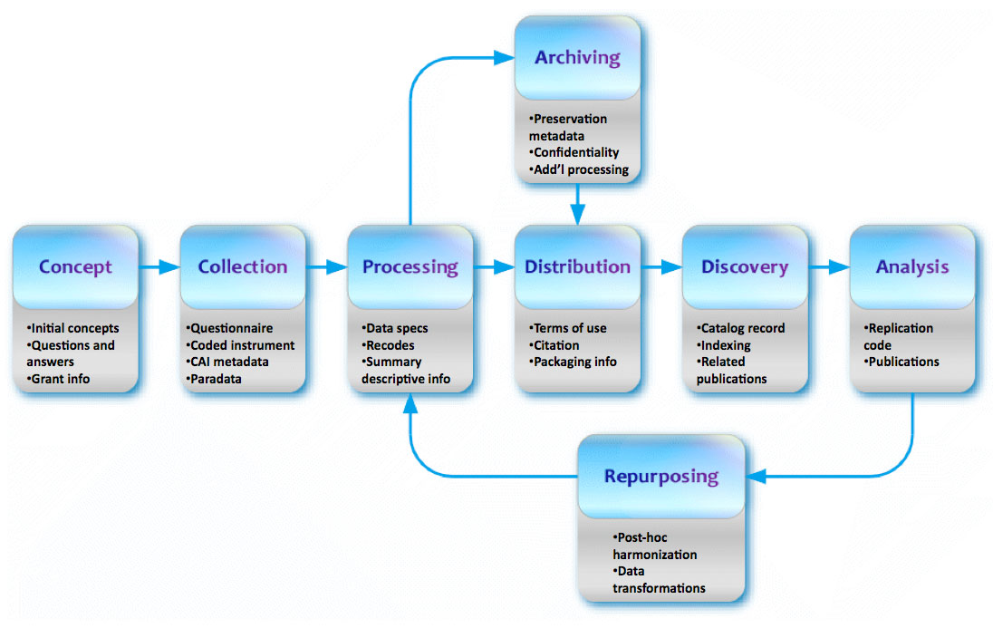
DDI-Lifecycle Model

Slide 11
Recommendations (I)
Preserve the raw data, but remove variables such as name, social security number, and home address
Use Data Disclosure Control Methods
most basic methods for maintaining privacy
include limitation of details, top/bottom coding, suppression, rounding and addition of noise
Management system to handle data sensitivity levels and access rights

Slide 12
Recommendations (II)
A system with functionalities similar to those of Statistical Metadata System (SMS) could be used to manage sensitive health-related data!
Access to data objects according to users’ and user groups’ rights!

Slide 13
Recommendations (III)
Use:
standardized and
globally accepted file formats
Assure accessibility according to retention policies!
Always have Data/Records Management Plan!

Slide 14
CONCLUSION
Interdependence between the needs of psycholinguistic research and available models and standards in official statistics
Solutions considered here include the ones for
data collection
statistical survey processing, and
records management
Knowledge and solutions from official statistics and modern archival science could be combined!

Slide 15
THANK YOU!
Long-term Preservation
of Longitudinal Statistical Surveys in Psycholinguistic Research
Hrvoje Stančić
Faculty of Humanities and Social Sciences, Zagreb, Croatia
hstancic@ffzg.hr
Martina Poljičak
Central Bureau of Statistics, Zagreb, Croatia
poljicakm@gmail.com
Anabela Lendić
Faculty of Humanities and Social Sciences, Zagreb, Croatia
alendic@ffzg.hr

