Slide 1
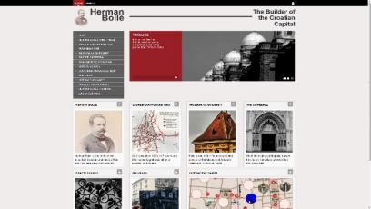
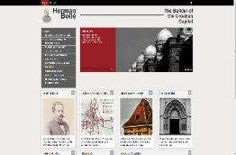
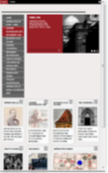
Cooperation of a Museum Institution and Students in Creating Virtual Exibitions Using the Tool
________________________________
Goran Zlodi, Josip Mihaljević, Anica Šimunec, Paula Mikeli, Ivana Rudić

Slide 2
Cooperation of museum and academic community
Museum of Arts and Crafts in Zagreb (main Croatian AthenaPlus project partner)
Department of Information and Communication Sciences at the University of Zagreb Faculty of Humanities and Social Sciences (course Virtual museum within Graduate programme of museum study and heritage management)
Creating of two digital exhibitions using the MOVIO tool
For Better or Worse… / Wedding Clothes from 1865 to Nowadays (http://54.247.69.120/build/movio/movioTraining39/)
Herman Bollé – The Builder of the Croatian Capital (http://54.247.69.120/build/movio/movioTraining40/en/)

Slide 3
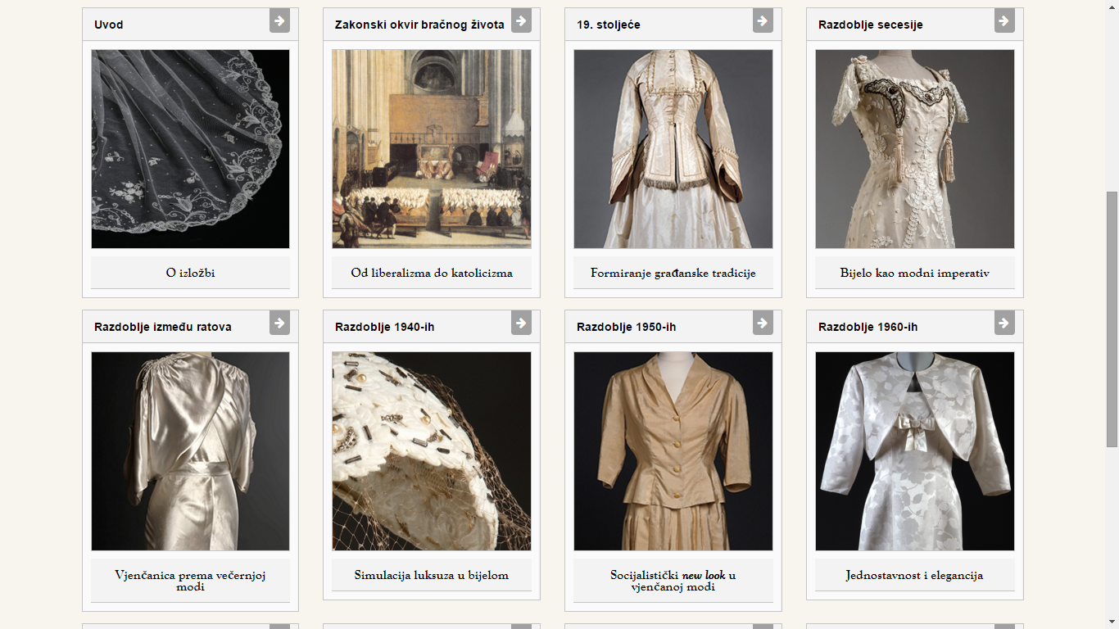

Slide 4
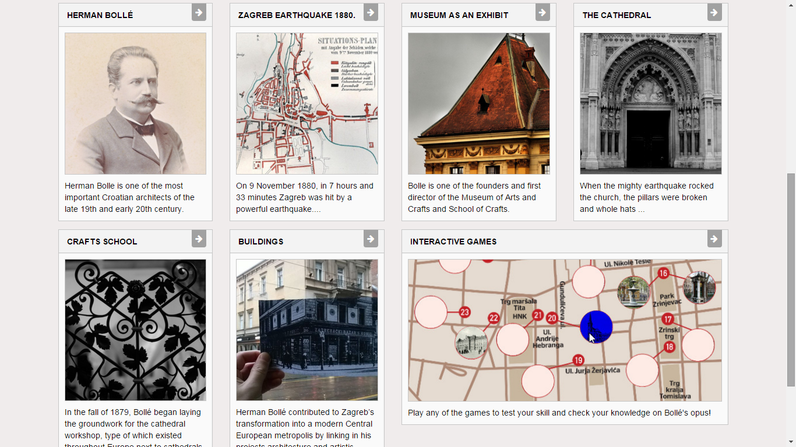

Slide 5
AthenaPlus (2013-2015)
Consortium:
40 partners from 21 EU Member States
Main goals:
3,6 millions records aggregation to Europeana
Improvement of the aggregation platform (MINT)
Semantic enrichment of cultural metadata with Linked Data
Implementation of the Terminology Management Platform
Development of creative applications for cultural content (MOVIO, CityQuest, ...)
Notes:
Let’s say few words about AP project within this coooperation was held...

Slide 6
tool
MOVIO is a tool for the creation of digital exhibitions
Open-source content management system (CMS) for cultural heritage content
Focuses on creating interactive multimedia content
digital photo galleries and exhibitions
timelines
digital storytellers
Support for multilingualism
transfers the content from default language to other languages automatically
Can be easily and efficiently used by users with minimum of IT knowledge
Notes:
and what is very importante – it can be easily

Slide 7
Content development and re-use
Notes:
I will stress few added values that students also developed for this exhibitions. For exhample they created pages for twentysix Bolles buildings. (compiled from various sources, even photographed)

Slide 8
Interactive games
Notes:
Students also developed 5 interactive games (puzzles, memory game, and one very atractive - interactive map – all in Unity engine)

Slide 9
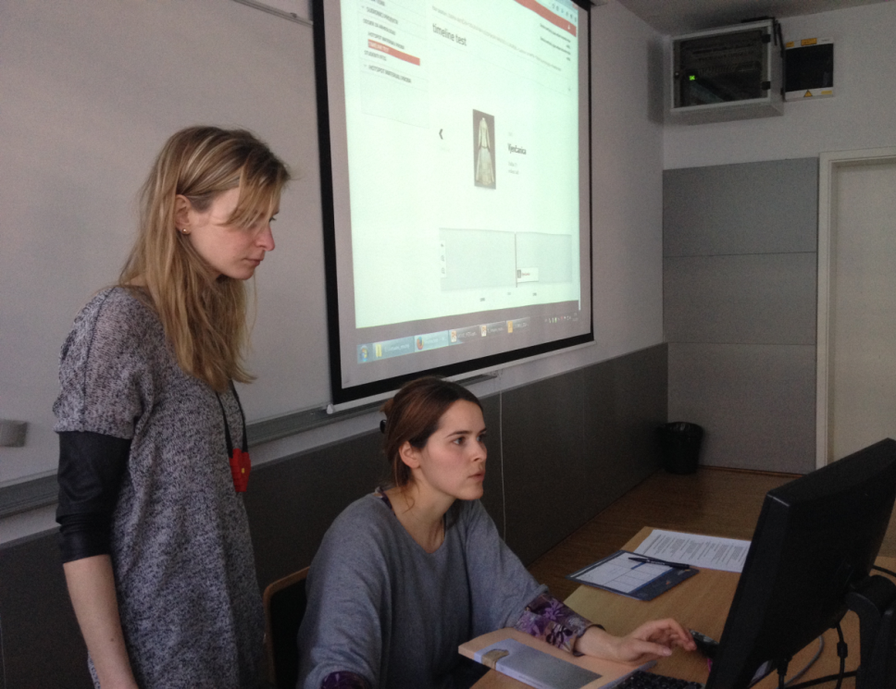
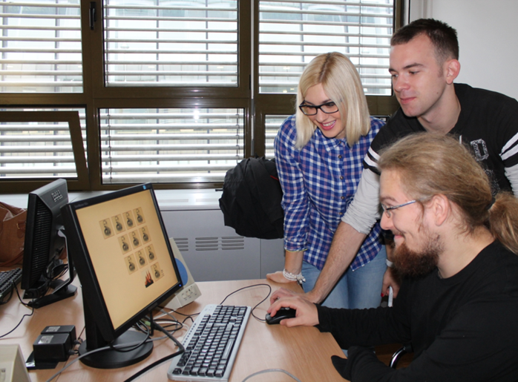
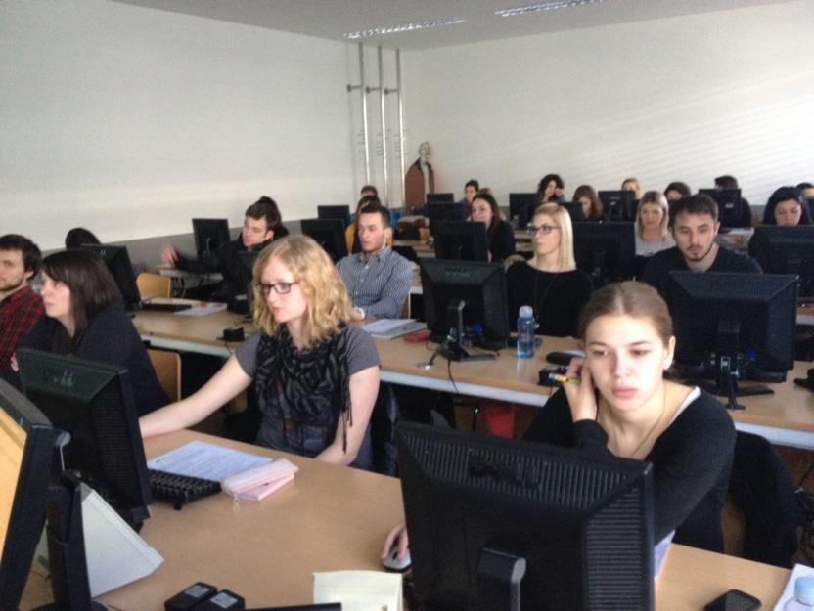
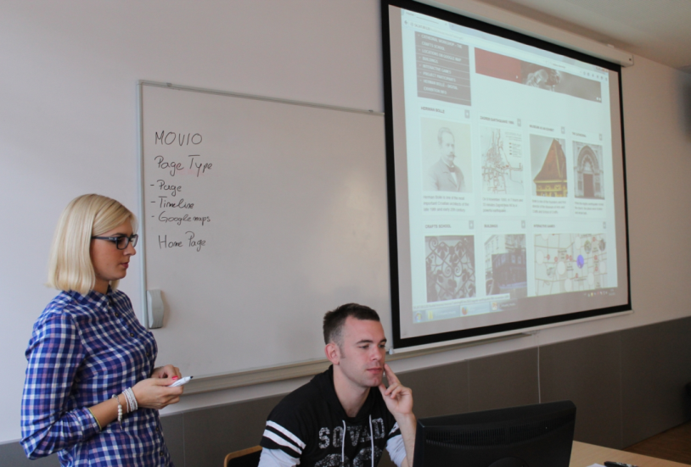
Notes:
1) For example. Here you can see how coleagues from museum give students initial training. And students at work...

Slide 10
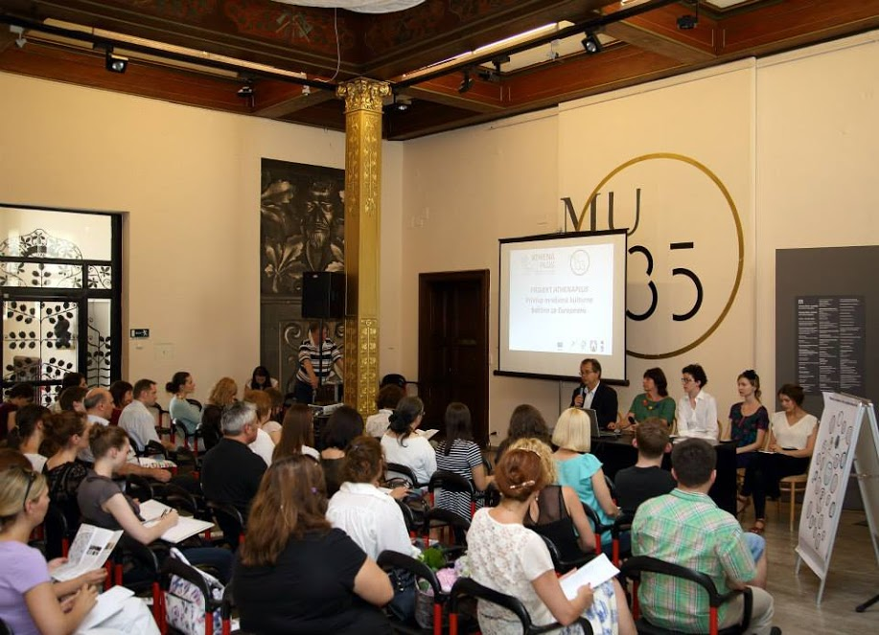
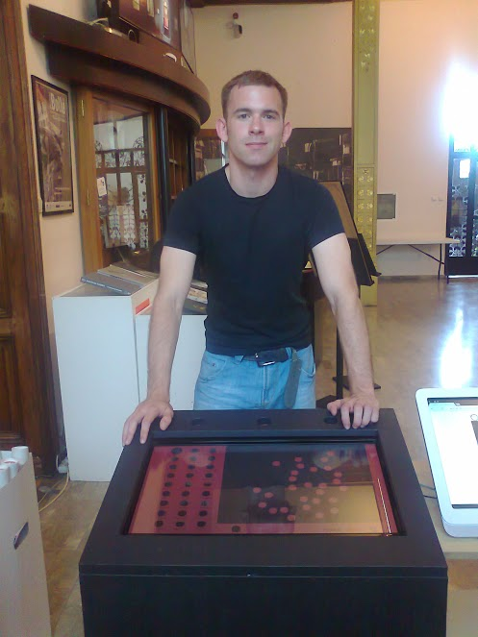
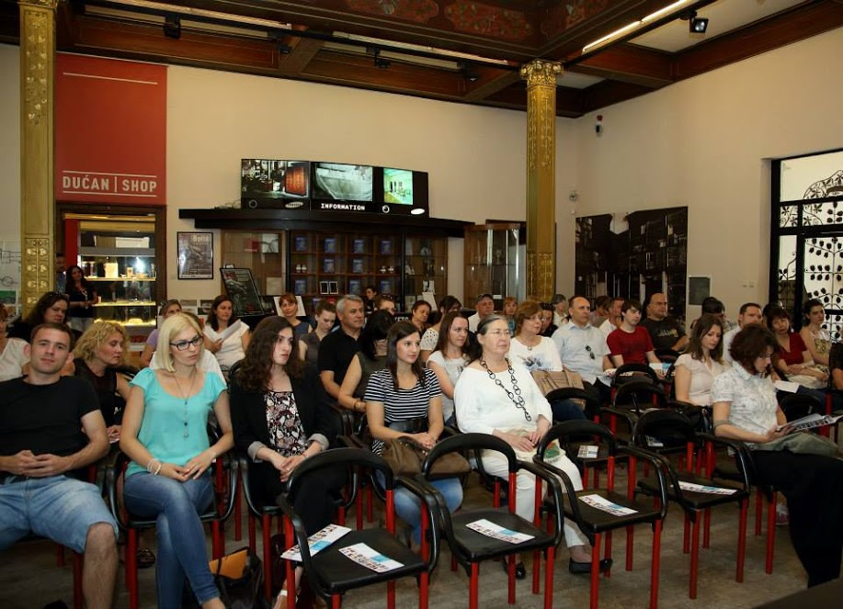
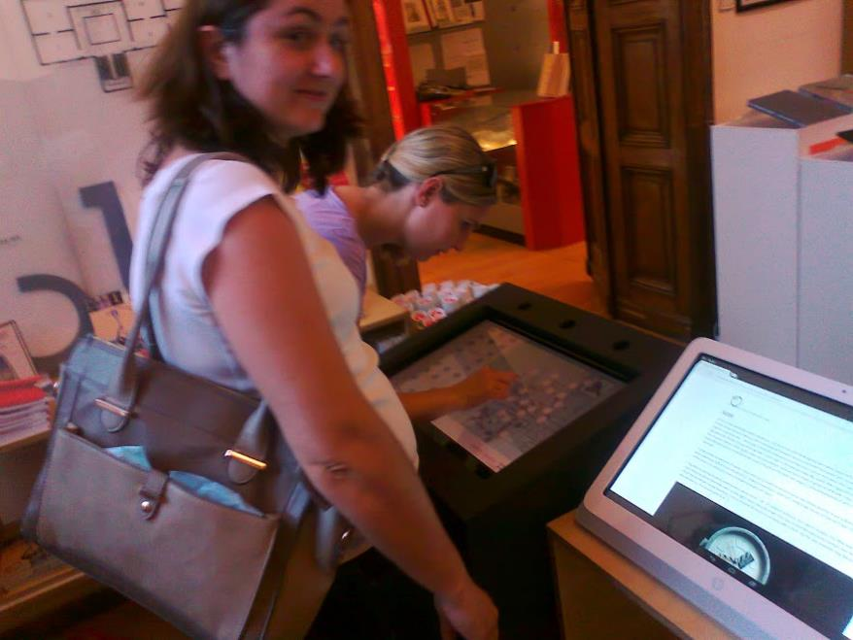
Notes:
And participation at final presentation of Croatian AthenaPlus project..

Slide 11
Instead of conclusion
MOVIO makes creating virtual exhibitions of complex and rich cultural content easier
cooperation of academic and heritage community
Benefits for students
students develop technical skills
students practice new creative ways to present exhibition content
Benefits for cultural heritage institutions
important (physical) exhibitions continue to live in virtual environment
Benefits for end-users
cultural content is more accessible, usable and interactive
Notes:
Before I give floure
And now I will give flour to coleageue Anica Šimunec who can give you quick tour trhough exhibitions, .

Slide 12
Thank you for your attention!
13 November 2015 Zagreb

