Slide 1
Information Transfer through
Online Summarizing and Translation Technology
Sanja Seljan*, Ksenija Klasnić**,
Mara Stojanac*, Barbara Pešorda*, Nives Mikelić Preradović*,
Faculty of Humanities and Social Sciences, University of Zagreb
*Department of Information and Communication Sciences,
**Department of Sociology

Slide 2
Outline
Introduction
Related work
Online text summarization tools
Online translation tools
Research Methodology
Results
Conclusion

Slide 3
I. Introduction
information and communication technology – important role in information transfer
information access, cross language retrival and information transfer – one step further in global communication
online summarization and machine translation
  evaluation of information transfer

Slide 4
II. Related work
Europe Media Monitor (EMM) – automatic public service
MiTAP and MITRE
summarization in medical domain
MuST – multilingual information retrival, summarization and translation system
cross-language document summarization
information system for legal professionals

Slide 5
III. Online text summarization tools
„Text summarization represents a method of extracting relevant portions of the input document, presenting the main ideas of the original text...“ (Mikelic Preradović, Vlainic, 2013)
various summarization systems – statistical, linguistical or combined approach
basic types of summaries – indicative and informative
summarization techniques – surface methods, entity level, discourse level methods
summarized text should give the answers to questions: who, what, when, where, and how?

Slide 6
IV. Online translation tools
machine translation technology - education market, the international institutions …
quick and easy translation from one natural language into another
  first access to information on other languages (for information assimilation)
  widely used – free translation tools
the aim – to show the impact of online machine translation tools to information transfer
knowledge of the tools that are of good quality, precision and accuracy → automatic / human evaluation

Slide 7
V. Research Methodology
three respondents (native Croatian speakers)
corpus: texts from English, German and Russian language
  five different categories for each language (politics, news, sport, film and gastronomy)
the total of N=240 evaluations were analysed
  in the first task 90
  in the second task 90 evaluations
  in the third taks 60 evaluations

Slide 8
V. Research Methodology
the first assignment – evaluation of machine-translated sentences at the sentence level
three language pairs (English-Croatian, German-Croatian and Russian-Croatian)
two online translation tools (Google Translate and Yandex Translate)
texts on English and German were firstly summarized and then machine translated
  summarization by online tool Swesum: from 108 sentences to 47 sentences in English and from 103 sentences into 49 sentences for German
average score ranging from 1 to 5

Slide 9
V. Research Methodology
the second assingment – quality evaluation of the whole text (score ranging from 1 to 5)
the third assignment – related to information transfer
  evaluation of the overall quality of the summarized and translated text from English and German language
  giving the answers to the questions who, what, when, where and how?

Slide 10
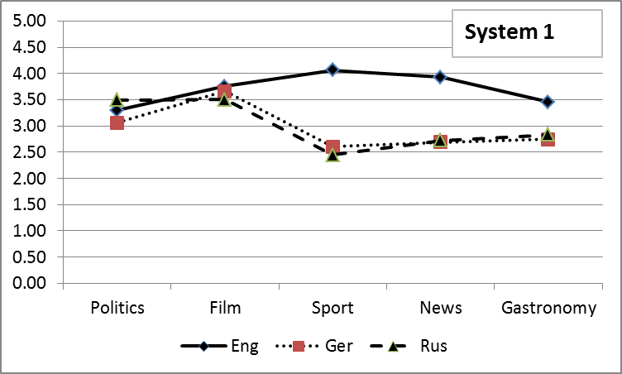
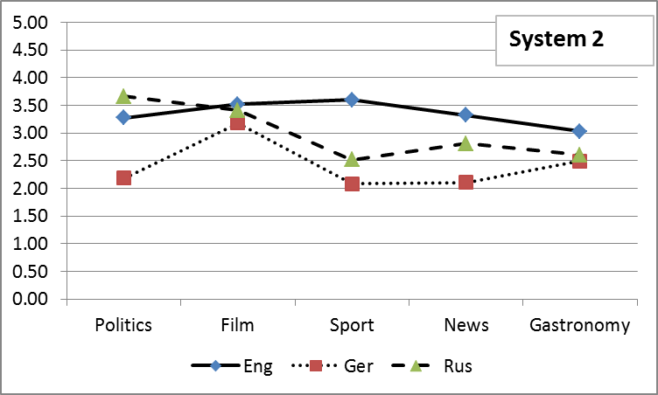
VI. Results
Description - mean accuracy scores
MT system 1 (Google Translate)
MT system 2 (Yandex Translate)

Slide 11
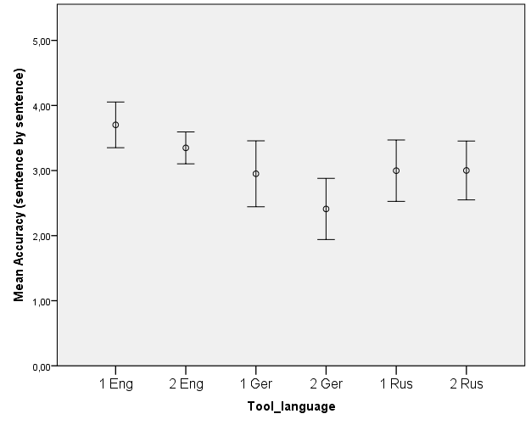
1. Evaluation at the sentence level
Error bars (mean and 95% CI for means): accuracy by tool and language
One-way between
subjects ANOVA
[F_{(5,84)}=4.78, p=.001]
with post hoc
comparisons
using the Tukey HSD
 No statistically
significant difference
among tools compared
by the same
language pair
(e.g. English-Croatian
for both tools) when
transmitting
information.
Two statistically
significant mean
diferences were found.
MT system 1 (Google Translate)
MT system 2 (Yandex Translate)

Slide 12
1. Evaluation at the sentence level
Error bars (mean and 95% CI for means): accuracy by tool and language
One-way between
subjects ANOVA
[F_{(5,84)}=4.78, p=.001]
with post hoc
comparisons
using the Tukey HSD
Google Translate
from English to Croatian
resulted in higher mean
accuracy than Yandex
Translate from German
to Croatian (p<.001)
MT system 1 (Google Translate)
MT system 2 (Yandex Translate)

Slide 13
1. Evaluation at the sentence level
Error bars (mean and 95% CI for means): accuracy by tool and language
One-way between
subjects ANOVA
[F_{(5,84)}=4.78, p=.001]
with post hoc
comparisons
using the Tukey HSD
Yandex Translate
from English to Croatian
resulted in higher mean
accuracy than Yandex
Translate from German
to Croatian
(p<.001).
MT system 1 (Google Translate)
MT system 2 (Yandex Translate)

Slide 14
2. Evaluation at the text level
Comparison of sentence by sentence mean scores and text evaluation mean scores
Quality evaluation of sentence
by sentence translation has
statisticaly higher overall mean
score than quality evaluation of
translation of the text as a whole
[t(89)=7.20, p<.001]
MT system 1 (Google Translate)
MT system 2 (Yandex Translate)

Slide 15
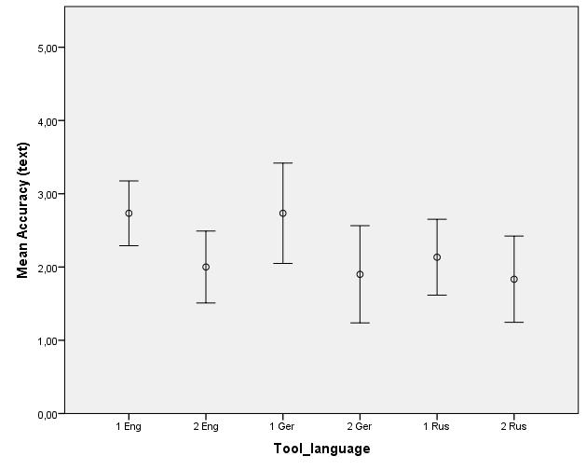
2. Evaluation at the text level
Error bars (mean and 95% CI for means): accuracy by tool and language
One-way between
subjects ANOVA
[F_{(5,84)}=4.78, p=.001]
with post hoc
comparisons
using the LSD test
 One statistically
significant difference
among tools compared
by the same
language: for German
language.
Additional three
statistically significant mean diferences between languages.
MT system 1 (Google Translate)
MT system 2 (Yandex Translate)

Slide 16
2. Evaluation at the text level
Error bars (mean and 95% CI for means): accuracy by tool and language
One-way between
subjects ANOVA
[F_{(5,84)}=4.78, p=.001]
with post hoc
comparisons
using the LSD test
Google Translate from English to Croatian resulted in higher mean accuracy than Yandex Translate from German
to Croatian (p=.030).
MT system 1 (Google Translate)
MT system 2 (Yandex Translate)

Slide 17
2. Evaluation at the text level
Error bars (mean and 95% CI for means): accuracy by tool and language
One-way between
subjects ANOVA
[F_{(5,84)}=4.78, p=.001]
with post hoc
comparisons
using the LSD test
Google Translate from English to Croatian resulted in higher mean accuracy than Yandex Translate from Russian to Croatian (p=.019).
MT system 1 (Google Translate)
MT system 2 (Yandex Translate)

Slide 18
2. Evaluation at the text level
Error bars (mean and 95% CI for means): accuracy by tool and language
One-way between
subjects ANOVA
[F_{(5,84)}=4.78, p=.001]
with post hoc
comparisons
using the LSD test
Google Translate from German to Croatian resulted in higher mean accuracy than Yandex Translate from Russian to Croatian (p=.019).
MT system 1 (Google Translate)
MT system 2 (Yandex Translate)

Slide 19
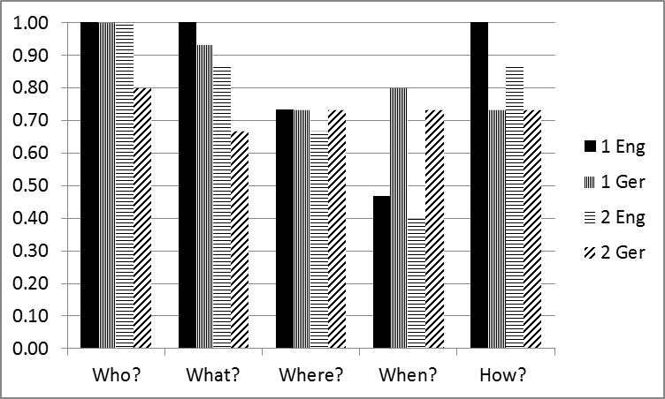
3. Information transfer evaluation
Information transfer in summaries across all domains
Codes:
0 = NO
1 = YES
Overall average information scores by language:
German 3.8
English 4.4
Overall average information scores by question:
who? 0.95
what? 0.87
how? 0.83
where? 0.72
when? 0.60
MT system 1 (Google Translate)
MT system 2 (Yandex Translate)

Slide 20
3. Information transfer evaluation
Additional analysis:
Binary logistic regression analyses was used to test whether accuracy evaluations for English-Croatian and German-Croatian translations of both systems can predict the odds of giving the answers to five listed questions. This analysis was performed on sentence level because of higher accuracy scores.
Accuracy has shown to be statistically significant predictor only for the odds of giving the answers to how? question.
Analysis showed that for a one-unit increase in accuracy on sentence by sentence level the odds of giving the answer to the question how? for transmitted information increases 6.3 times (95% C.I.: 2.1 – 18.5) (p=.001).

Slide 21
VII. Conclusion
We presented the data on information transfer in five domains (politics, news, sport, film and gastronomy) for texts taken from online newspapers for 3 languages (English, German and Russian). In the research three types of assignments were made.
Notion: preliminary study due to small number of test data analysed in this pilot research.
Taken together, results suggest significant differences in information transfer when using different online tools. Although they work best for the English language, there are significant differences among other languages and online tools.
The user information perception gave significantly higher scores in sentence by sentence evaluation, than on the whole text evaluation.
We detected a significant connection between accuracy and the ability to answer the question how?.

Slide 22
Thank you!
Sanja Seljan*, Ksenija Klasnić**,
Mara Stojanac*, Barbara Pešorda*, Nives Mikelic Preradovic*,
Faculty of Humanities and Social Sciences, University of Zagreb
*Department of Information and Communication Sciences,
**Department of Sociology
Contact: sseljan@ffzg.hr

