Slide 1
A project management approach to long-term preservation of optical media tasks
Arian Rajh
Department of Information and Communication Sciences,
Faculty of Humanities and Social Sciences, University of Zagreb
Ivana Lučića 3, Zagreb, Croatia
Agency for Medicinal Products and Medical Devices
Ksaverska c.4, Zagreb, Croatia
rarian_sp@yahoo.com

Slide 2
Archivist
Questioning paradigm (Ridener 2009) + influence of ICT domain
Archivist as active expert (appraisal, creation of archives)
Connecting technological possibilities and professional requirements
Increasing number of projects related to LTP
(Typical) archivist as member of project team or project manager
lacks formal PM experience…
but he or she should be visionary in professional sense, captain in organisational sense…and firefighter as well!

Slide 3
Inner drive
Initial problems
Producer of records is not (always) aware of archival requirements
Using different media for transfer (emphasis on the purpose of carrier)
Damage of media and deterioration
Furthermore
Records on optical media carriers that have not yet been migrated into document and records management system are in risk while awaiting copying (Stančić, Rajh, Tušek, 2008)

Slide 4
Inner drive
Case study
HALMED - Croatian authority for regulation of medicinal products, medical devices and homeopathic medical products
implemented document and records management system in 2014 (Digital archival information system, DAIS)
FileNet P8 platform, Content navigator, Enterprise records, Migration and ingest module and other modules, two repositories (ROS for document management, FPOS in conjunction with archival application)

Slide 5
Inner drive
Case study
DAIS implemented by Ericsson Tesla, archival application by Omega Software
Archive accumulated a large amount of compact discs over time, backlog
Migration drive in the case of submitted optical media is prevention of media decay

Slide 6
Migration
Record
set of data collected from the storage, dispatched to a memory, represented by review or edit software, and shown on user’s screen
authenticity of digital record is not necessarily tied in with the notion of digital media as a carrier
Migration
several types of migration according to OAIS model/standard, from simple migration to complex migrations – refreshment, replication, repackaging and transformation

Slide 7
Migration
Migration in HALMED – process
registration of SIP package on optical media into archival application with barcoding of the physical technical unit (disc)
copying folders and files into folder with the same barcode
migration of files by document and records management system DAIS into new digital technical unit
automatic registration of new digital technical unit into archival application linked to DAIS
automatic file conversion into PDF/A (Aspose)

Slide 8
Migration
Migration in HALMED – characteristics
folder structure is kept on conceptual level, although storage itself is organised differently
Structure kept in document module of DAIS system
Organisation - metadata in database and objects in file storage until its replacement with archival storage, i.e. EMC Isilon
content is linked with original unit through barcode identifier provided by archival application
metadata are re-used through this linking
standardisation of file format (PDF/A)
process is well-documented (DAIS documentation) and prescribed in formal internal act

Slide 9
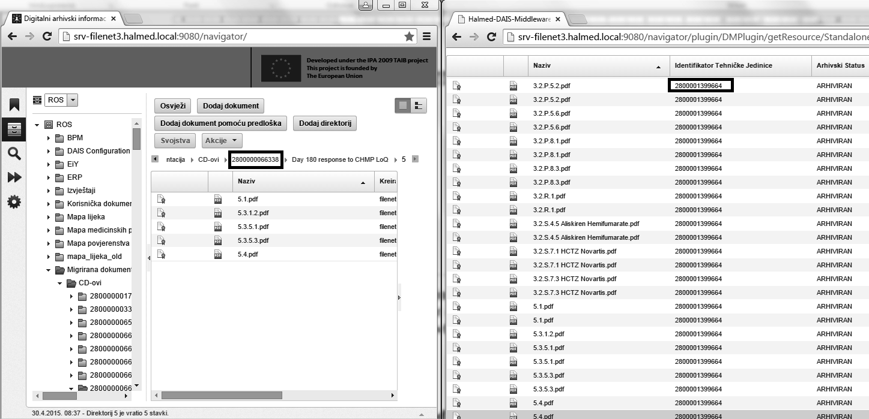
Presentation of structure in document and records management system
(FileNet based DAIS system developed by Ericsson Nikola Tesla & archival application developed by Omega Software)

Slide 10
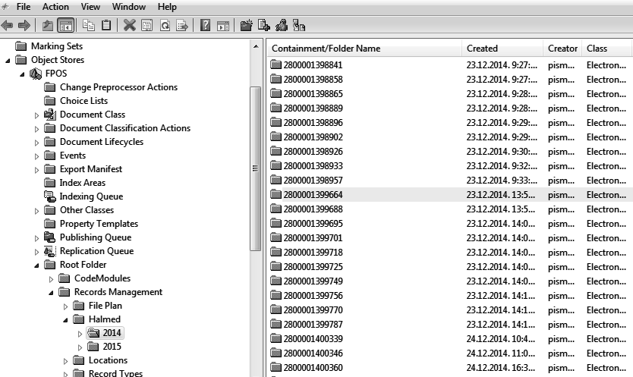
Content in FPOS store (FileNet based DAIS system, developed by Ericsson Nikola Tesla)

Slide 11
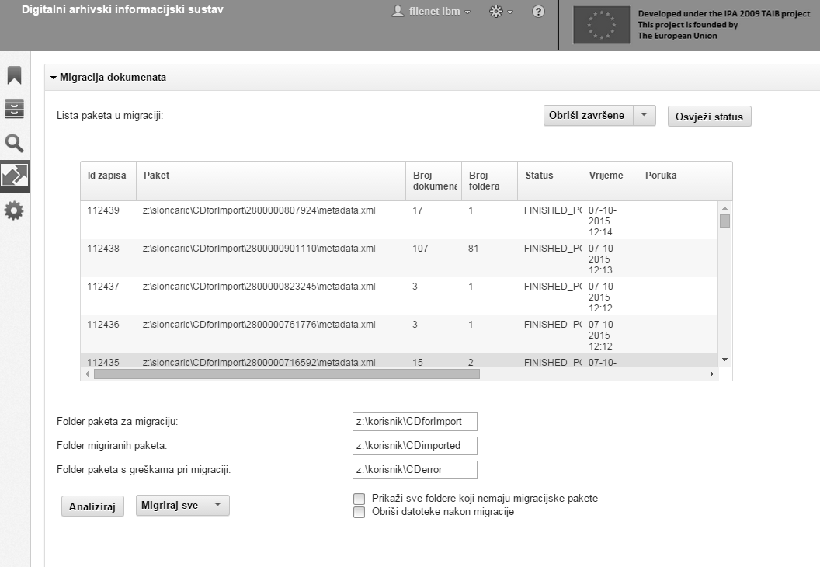
Migration
Migration in HALMED – task organisation
as regular use cases (or daily work)
as projects dealing with backlog incurred before DAIS
DAIS system migration module in HALMED (developed by Ericsson Nikola Tesla d.d.)

Slide 12
Projects
2008
Pilot project – Stančić, Rajh, Tušek
Checking the readability of optical media, defective media were detected
CDR media code identifier, CD-R diagnostic, and DVDisaster applications
Sample of 297 CDs
2014
Tasks pertained to one of the result of IPA 2009 TAIB project (DAIS)
4.567 CDs/DVDs migrated, 570 GB and they contained 376.501 files, 1.73% unreadable
2015
Students practice project
3.812 CDs/DVDs migrated, 1.27% unreadable
2015
Internal project
10.697 CDs/DVDs migrated (95%, 7.10.15), 1.79% unreadable
Total: over 19.000 CDs/DVDs migrated (Oct.15)

Slide 13
Project management
Methodology
Internal methodology (2014, Rajh, Gospodnetić)
Customised training (Primakon)
Projects are documented
Quality control
ensured by validation function in Migration and ingest module of DAIS
Also ensured by checking the links in DAIS from archival application
Risks and issues
Error rates
Risk related to DAIS system stress (several persons start migration at the same time)
Some of the older CDs were inserted into binders with paper documents by HALMED’s applicants/producer of records (lack of identifier)

Slide 14
Project management
Project records
Project proposal
Project charter
Risk analysis
Lessons learned
Project plan
Monthly communication between project manager and internal project management working group

Slide 15
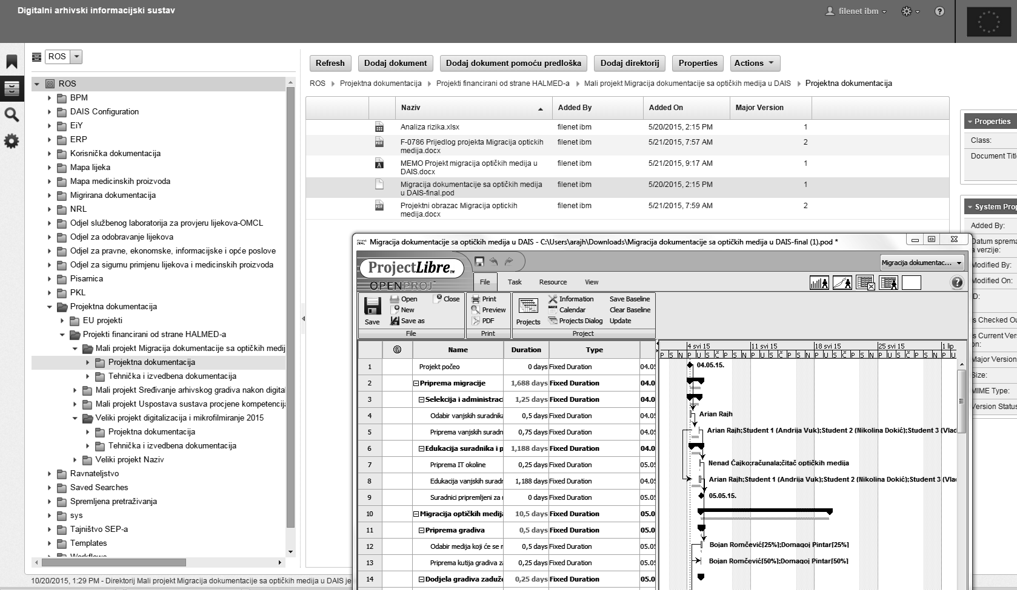
Project management
Student practice migration project - project environment in DAIS system and Project plan file (ProjectLibre application)

Slide 16
Some closing thoughts
LTP of digital records is very demanding, and it can help a little if organisation cuts optical media unpredictability out of the equation
this does not mean that creator should not check policy, procedures and system regularly
Recommendation is to do migration from widespread recordable optical media to records management or file systems as daily process or to prescribe submission of more stable media

Slide 17
Some closing thoughts
Additionally: archival standards for file formats, using embedded non-copyrighted fonts, using standardised metadata, ensuring that migrated content is protected
If creator accumulated/inherited backlog, it should launch a migration project/programme with formal project management intellectual tools due to projects’ complexity

Slide 18
Possibilities
Possible next steps related to migration (and digitisation) projects:
Founding of specialised archive in order to use and exploit gained experience and technology through technical assistance/service for sector/private corporations?
Project management for specialised projects (how to organise and control ingest)
Consultancy related to submission information packages (what goes in)
Digitisation (by which instrument)
Archiving in the cloud (…and where)

Slide 19
Literature
Critical Capabilities for Scale-Out File System Storage, 27 January 2015, http://www.gartner.com/technology/reprints.do?id=1-28XVMOC&ct=150130&st=sb (accessed 24/7/2015)
Final Report for the Contract “Development of the Digital Archive information system software in the Agency for Medicinal Products and Medical Devices, Republic of Croatia” EuropeAid/132507/D/SER/HR, Ericsson Tesla, 2014
HALMED is implementing a one year IPA project “Preparation for eCTD and implementation of digital archival information system”, 1/4/2014 http://www.halmed.hr/?ln=en&w=novosti&d=2014&id=1053 (accessed 30/4/2015)
Instructions for applicants for submitting the conventional dossier for medicinal products, 2009, http://www.halmed.hr/?ln=en&w=lijekovi&d=dokumentacija (accessed 5/5/2015)
INTERPARES Project. Storage Media (Characteristics and Composition) - Media. Draft appendix. October 2001. www.interpares.org/documents/media.pdf (accessed 30/4/2015)
INTERPARES 2 Project. Preservation Task Force Report. http://www.interpares.org/book/interpares_book_f_part3.pdf (accessed 29/4/2015)
National competence baseline, Croatian version 3.0, Zagreb: Croatian association for project management. 2008. Page 15. http://capm.hr/preuzimanja/ (accessed 30/4/2015)
Preparations for eCTD and implementation of digital archival information system. 17/9/2014, http://www.safu.hr/en/news/preparations-for-ectd-and-implementation-of-digital-archival-information-system (accessed 30/4/2015)
Rajh, A. Sustavi za upravljanje digitalnom dokumentacijom – nove mogućnosti i novi izazovi za stvaratelje i arhive, Arhivski vjesnik (Bulletin d'archives) 58/2015 (Manuscript submitted for publication, forthcoming 2015)
Rajh, A.; Šimundža – Perojević, Z. Digitalizacija, prihvat i migracija gradiva u sustav upravljanja zapisima sa ciljevima ostvarivanja temeljnih funkcija HALMED-a i očuvanja gradiva. Studija slučaja. Radovi 48. savjetovanje Hrvatskog arhivističkog društva, Topusko 2015.
Reference model for an open archival information system (OAIS), Recommended practice CCSDS 650.0-M-2. June 2012, http://public.ccsds.org/publications/archive/650x0m2.pdf, p. 5-3 (accessed 30/4/2015)
Shahani, C.J., Manns, B., Youket, M. Longevity of CD media: Research at the Library of Congress, Preservation of Electronic Records: New Knowledge and Decision–Making: Post Prints of a Conference, Symposium 2003, 197–206. Ottawa: Canadian Conservation Institute, 2005
Slattery, O.; Lu, R.; Zheng, J.; Byers, F.; Tang, X. Stability Comparison of Recordable Optical Discs—A Study of Error Rates in Harsh Conditions, Journal of Research of the National Institute of Standards and Technology, Volume 109, Number 5, September-October 2004
Standard operative procedure AG-ARR-0005 Ingest of SIPs and migration of optical media, 1st ed., HALMED, 2015
Standard operative procedure AG-OP-0053 Project management, 2nd ed., HALMED, 2015
Stančić, H.; Rajh, A.; Tušek, M. Are optical disks suitable for LTP?, 10/13th International Conference Information Technology and Journalism Collaborative Media and Content Management 15-23/5/2008
Stančić, H. Theoretical model of persistent preservation of authenticity of digital information objects, PhD dissertation. Zagreb: Faculty of humanities and social sciences, 2005
Shepherd, Elizabeth i Yeo, Geoffrey, Managing records – a handbook of principles and practice. London: Facet Publishing, 2003
Turner, J.R. (edt), Gower Handbook of Project Management, Aldershot: Gower, 2007

