Slide 1
Welcome to the jungle: science communication in the mediatized society
Tea Čonč and Denis Kos
University of Zagreb, Faculty of Humanities and Social Sciences
Department of Information and Communication Sciences Ivana Lučića 3, 10 000 Zagreb, Croatia
{tconc, dkos}@ffzg.hr

Slide 2
a report on a literature analysis
a theoretical investigation
areas for further research
Presentation structure
Regulation of science
Communication of science
Science production
Introduction

Slide 3
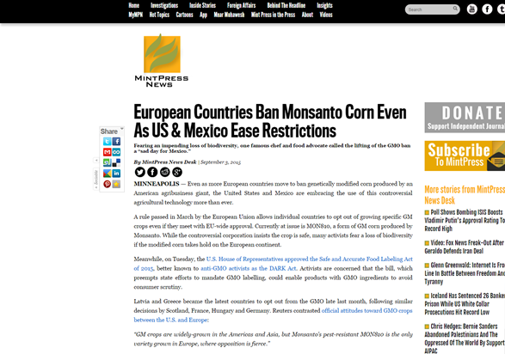
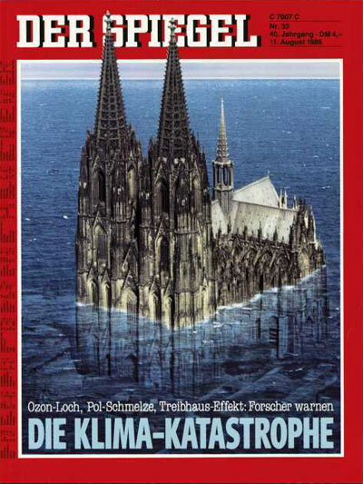
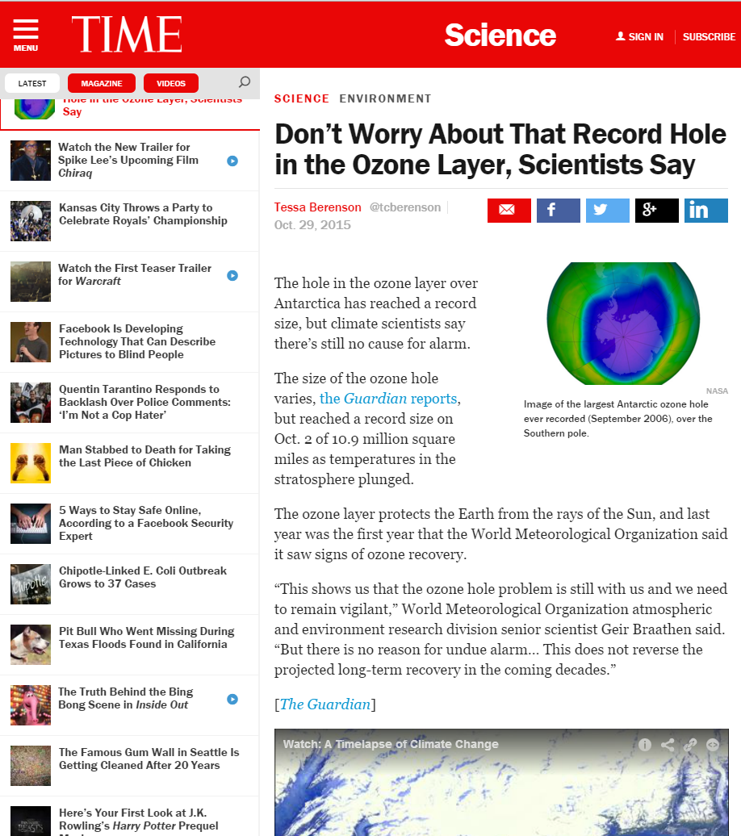
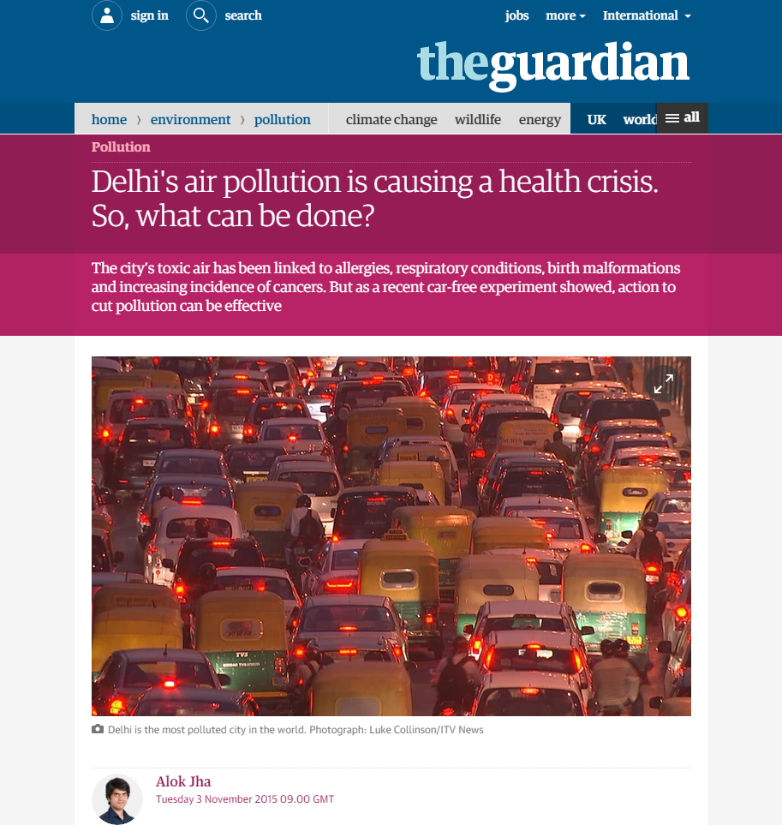
- scientific topics becoming much more exposed to the media
Context
3

Slide 4
rising influence of media on science
Mediatization – area of research that shows how different existing social systems change their inner rules and the ways they function to adopt (more or less consciously) a rationale based on a media logic
identification of recognized mediatization processes in science
two main approaches:
institutionalist
socio-technical
a selective literature analysis
Problem definition

Slide 5
centrality of the media
social system
Problem definition
social system
social system
the media
social system

Slide 6
a result of historic developments
complicated by the role of the media
proprietization vs. democratization
“politics seen as withdrawing from its original responsibility to make binding decisions”
assumption that the media have taken upon them to hold science accountable according to the principles of media logic
Regulation

Slide 7
an institutionalist approach
a lens of PR studies
4 notable tendencies of mediatization
institutional and individual self-promotion
increase of scientific (and/or political) impact
self-regulatory behaviour
simplistic mediation of scientific content
a turn towards the new media
Communication

Slide 8
a socio-technical approach
focus on the new media – accessible, democratic, open, participatory
3 notable tendencies of mediatization
achieving and improving scientific status
changes in scholarly publishing patterns
increase in informal scientific communication
Production

Slide 9
science overwhelmed
a negative understanding of mediatiazation –> a threat to autonomy and quality of research
need to investigate media strategies of scientific institutions
science communication is changing under the influence of new media
raises a different mediatization issue where media blur the criteria of scientificity
ensure that new scientists have the necessary skills to work in the new environment
Conclusion

Slide 10
Adolf, Marian. Clarifying mediatization. // Empedocles. 3 (2011), 2; 153–175.
Deacon, David; Stanyer, James. Mediatization: key concept or conceptual bandwagon? // Media, culture & society. 36(2014); 1032–1044.
Hepp, Andreas; Hjarvard, Stig; Lundby, Knut. Mediatization: theorizing the interplay between media, culture and society. // Media, culture & society. 37(2015); 314–324.
Hoskins, Andrew. Flashbulb memories, psychology and media studies. // Memory studies. 2(2009), 2; 147–150.
DC's improbable science: truth, falsehood and evidence: [blog]. http://www.dcscience.net (Access date: 2015-16-06)
Koltay, Tibor; Špiranec, Sonja; Karvalics, Laszlo Z. The shift of information literacy towards research 2.0. // The journal of academic librarianship. 41(2015); 87–93.
Lövgren, Daniel; Pallas, Josef. Blogging for reputation. // The governance of modern universities, 21-23 August 2013, Reykjavik, Iceland / Engwall, Lars (ed.), 2013.
Lüthje, Corinna. Mediatisierte wissenschaftsinterne Kommunikation: Stand der Forschung und theoretische Rahmung. // kommunikation @ gesellschaft. 15(2014).
Marcinkowski, Frank; Kohring, Matthias. The changing rationale of science communication: a challenge to scientific autonomy. // Journal of science communication. 13(2014), 3.
Nowotny, Helga. The changing nature of public science // The public nature of science under assault. / Novotny, Helga [et al.] (ed.). Berlin ; New York : Springer, 2005, 1-27.
References - 1

Slide 11
Peters, Hans Peter. Gap between science and media revisited. // Proceedings of the National Academy of Sciences. 110(2013); 14102–14109.
Peters, Hans Peter; Heinrichs, Harald; Jung, Arlena; Kallfass, Monika; Petersen, Imme. Medialization of science as a prerequisite of its legitimization and political relevance. // Communicating Science in Social Contexts / Cheng, Donghong [et al.] (ed.). Dodrecht; London : Springer Netherlands, 2008, 71–92.
Rhoten, Diana; Powell, Walter.W. The frontiers of intellectual property. // Annual review of law and social science. 3(2007), 1; 345–373.
Rödder, Simone; Schäfer, Mike. S. Repercussion and resistance: an empirical study on the interrelation between science and mass media. // Communications. 35(2010) 3; 249–267.
Strömback, Jesper. Four phases of mediatization. // The international journal of press/politics. 13(2008), 3; 228–246.
Šuljok, Adrijana; Vuković Brajdić, Marija. How the Croatian daily press presents science news. // Science & technology studies 26(2013), 1; 92–112.
Weingart, Peter. Science and the media. // Research policy. 27(1998), 8; 869–879.
References - 2

Slide 12
Thank you!

