Slide 1

e-Croatia 2015 going to 2020
mr. sc. Leda Lepri, dipl. ing.
Assistant Minister
Ministry of Public Administration
Republic of Croatia

Slide 2
The Committee for the Coordination of the Informatization of the Public Sector 2012
Ms. Milanka Opačić, Deputy Prime Minister, President
11 Ministers, members
11 Ministers, members
11 Ministers, members
11 Ministers, members
L.Lepri, AM, coordinator
D. Parić, adviser to the President

Slide 3


Integration of Base Registries
2012
2012
Birth, Death, Marriage Registry
Citizenship Registry
Voters list
2015
All official personal documents are issued in all registry offices in Croatia

Slide 4

COP – Central Salary System
RegZap - register of employees in the public sector:
  The organization of all institutions (2.200)
  Data of employees (250,000) who receive a salary from
  the state budget directly or indirectly (health)
COP
  Leans on data from RegZap (actually a single system)
  The calculation does not include 20 institutions
  Calculated at 250,000 salary
Advantage:
  View all paid by all elements
  Data preparation for negotiations with trade unions
  Simulations pay system
  Human Resources Management
Problems in implementation:
Different method of calculating wages due to various collective agreements

Slide 5

Overview of legal acts
Law on State Information Infrastructure
(ZoDII )(NN 92/14)
  ProDII - coordination of government projects
  single point of contact in the virtual world
  obligation to use data in basic registries – relieve citizens of administrative burden (Metaregistar)
Regulation on State Information Infrastructure
Regulation on ProDII
Decision on Council on State Information Infrastructure
Regulation on State Information Infrastructure

Slide 6
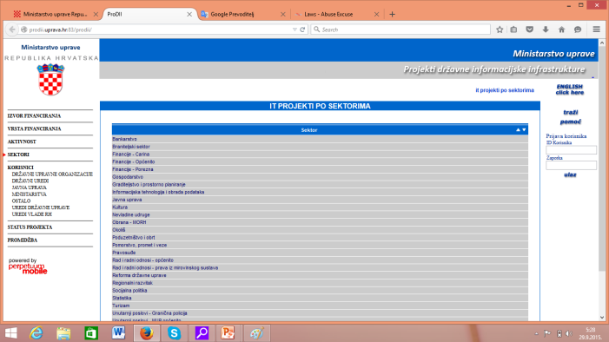
Public Register ProDII
Public Register for the
coordination of projects for
development of the state
information infrastructure
Purpose:
monitoring and coordination of ICT projects,
rationalization of investments in ICT projects within the public sector and
transparency of public administration regarding ICT projects

Slide 7

Metaregister
Collboration tool with the function:
inventory of all public registers (electronic or in books) with:
  their data
  available services for access and use of da¸ta in registries
  Intentions to change structure
  Responsible institutions and persons
collect data only once,
in electronic form
One of the basic elements of the interoperability system

Slide 8
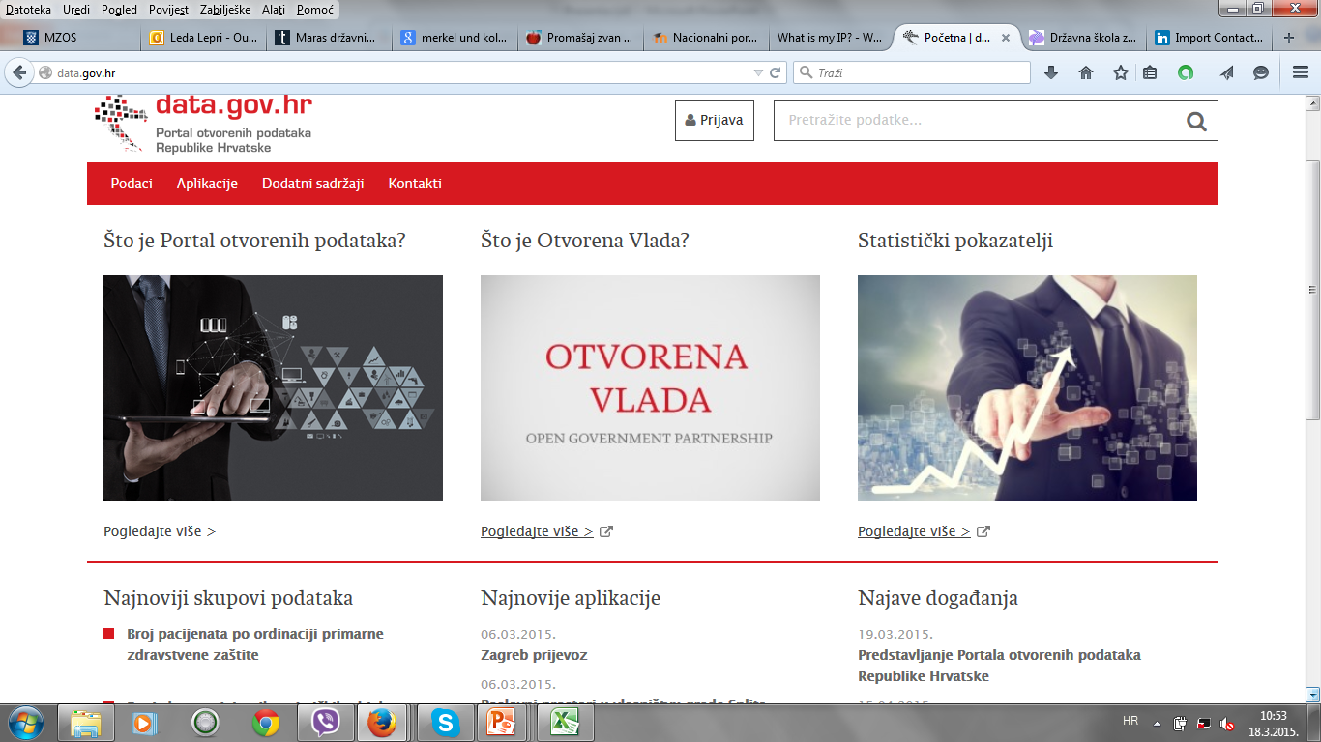
Open data portal data.gov.hr

Slide 9
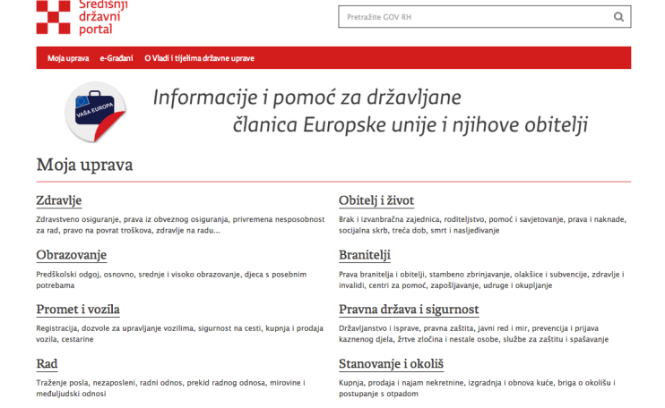
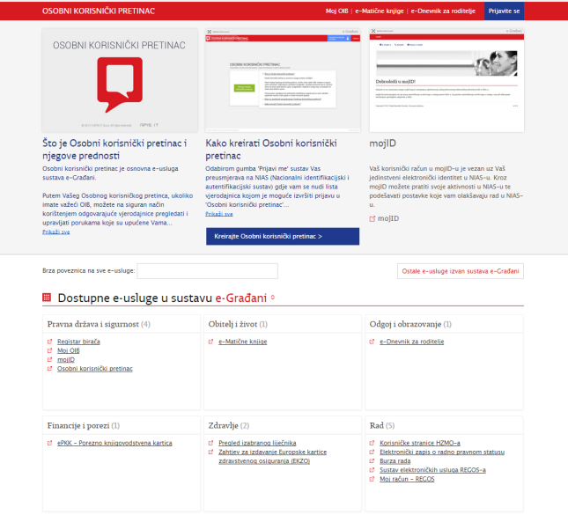
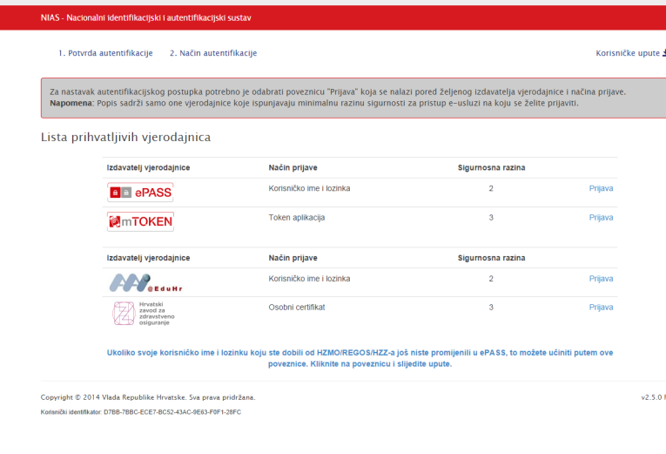
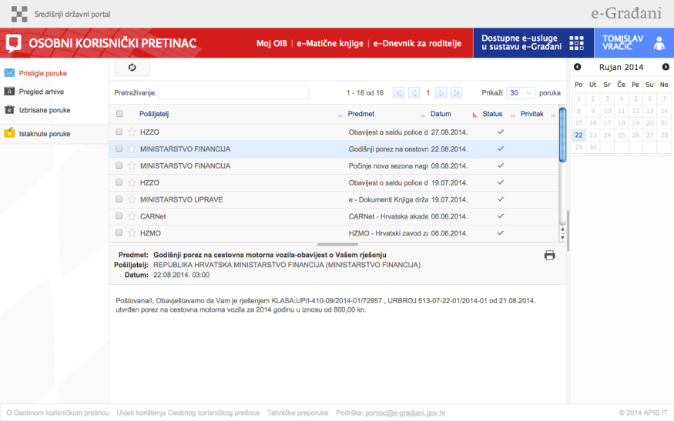
Multi-service approach
Public Administration Reform
CENTRAL GOVERNMENT PORTAL – GOV.HR
e-SERVICES
NATIONAL IDENTIFICATION AND AUTHENTICATION SYSTEM
e-CITIZEN INBOX

Slide 10
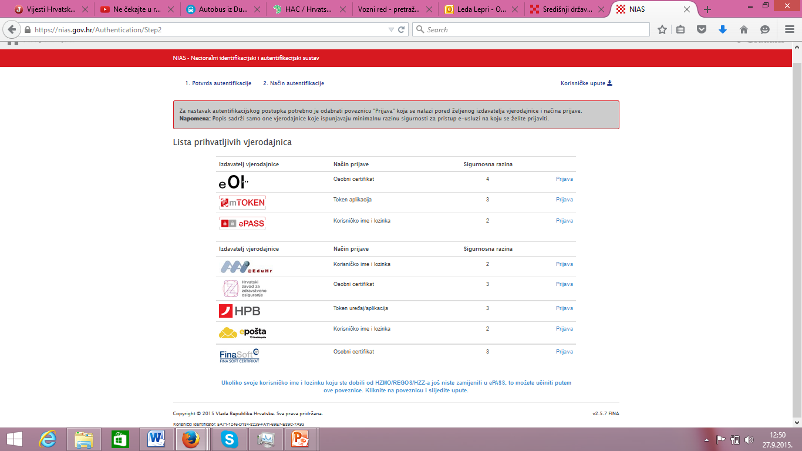
One username and password for all services - NIAS
Internet
banking access integrated

Slide 11
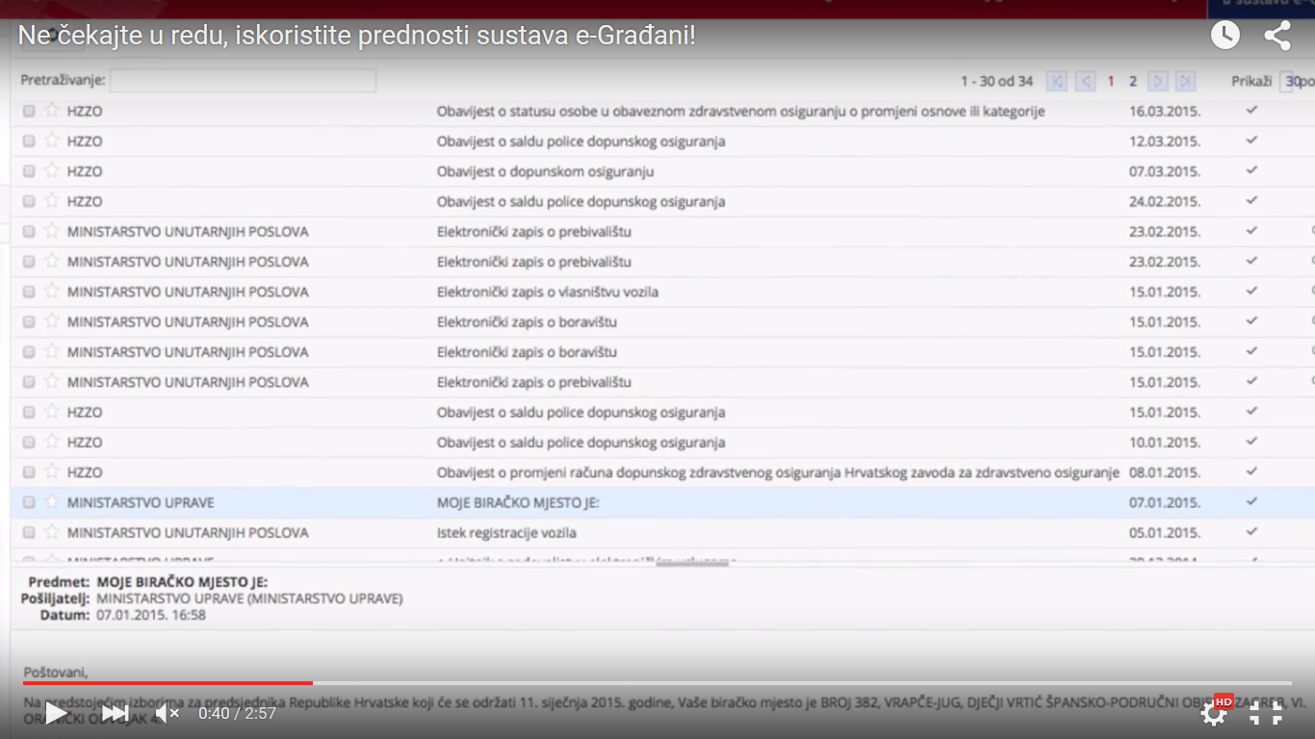
Personal Inbox

Slide 12
Top 5 e-Services out of 25
e-Registry books
  allows citizens to get official personal documents online
e-Prescription
  pick up a prescription in every pharmacy in Croatia
  access all prescriptions used in the past 6 months
e-Consultations
  provides citizens with an opportunity to directly comment on legal and policy documents
e-School Diary
  connects teachers, parents and students
  focuses on improving the quality of school education
e-Voters List
  Allows citizens to register to vote on a specific polling station
        …crafts

Slide 13
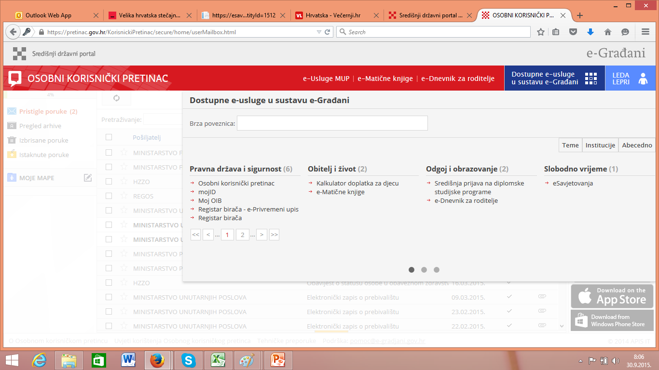
e-Citizens
Customer Oriented e-Government
Awarded as best regional innovative solution for the improvement of public services in Europe in 2015. in Mexico City on the summit of the Open Government Partnership initiative

Slide 14
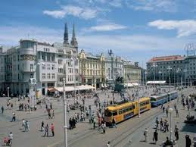
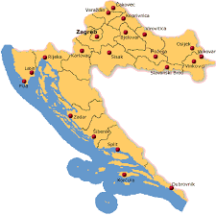

3 years ago….
Dubrovnik-Zagreb
2 days out of office and
Airplane: 85 €
Bus: 50 €
Blablacar: 45 €
Car: 160 €

Slide 15

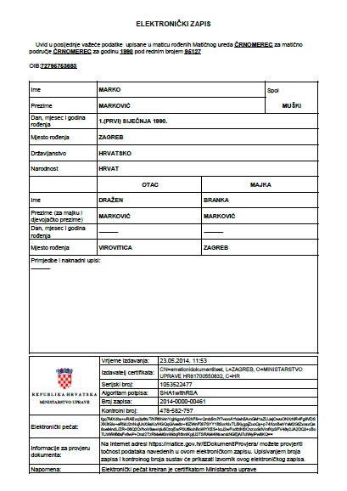
Today…
Dubrovnik-Zagreb
No day out of office
Cost: 0 €

Slide 16
e-Citizens Statistics
Croatia’s e-Građani (eCitizens) project was declared the best European eGovernment services project, in an awards ceremony at the Open Government Partnership Global Summit 2015 in Mexico
200.567 users of the portal
400 new users / day
from 14 e-services to 26 services
2 services/month
3.402.321 uses of e-services

Slide 17
Strategies
Draft National Cyber Security Strategy
Draft Broadband Development Strategy for the period od 2016. do 2020.
  Next Generation Access Networks 30 Mbit/s for all citizens;
  at least 50% of hoseholds => 100 Mbit/s
  Total IP allocation EUR 179,441,037 (ERDF)

Slide 18
Strategies
Draft e-Croatia 2020 Strategy
Public Administration Development Strategy
Shared Service Center as Cloud
  Interoperability
  Cloud infrastructure
  Common solutions
Sectoral e-services
  e-Health
  e-Land Administration
  e-Culture Strategy
  e-Tourism
  e-Justice
  e-Inclusion
OP CC EUR 104,447,155 (ERDF)
simplification and modernization of administrative procedures
improvement of the development and management of human resources
new form of the administrative system
OP EHR EUR 88,076,944 (ESF)

Slide 19
New Business Model Cloud Computing
A new business model, based on an analysis, was adopted by means of Governmental conclusion
Strategic body – Ministry of Public Administration
(e-Croatia Directorate)
Private sector
Public procurement
PSB 1
New IT solution
PSB 2
The application of a transition model
Business requirements
Analysis
Proposal
State Cloud service
PSB 3
PSB n
Notes:
Drafting a new solution:
Preparing the tender dossier (framework agreement)
Implementation of public procurement procedure
Selecting the tenderer(s)
Signing a contract with the Ministry
Signing a contract with a sub-contractor

Slide 20
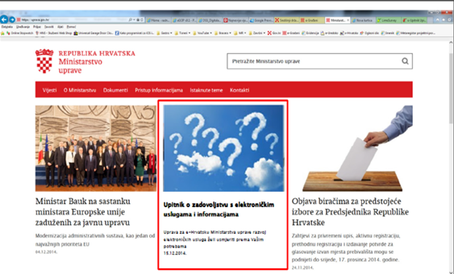
e-Croatia 2020 Strategy
Most important e-Services

Slide 21

e-BUSINESS PROJECT / BUSINESS USER MAILBOX

Slide 22
e-Business System
Project of GoC with the aim of facilitating the cooperation of the public administration and the business entities via the Internet
Online pilot as of October 1, 2015 at https: //*.gov.hr
The main components:
  Portal with public information for businesses
  National identification and authentication system for businesses (NIASeP)
  Business User Mailbox (PKP)
  e-Services for businesses

Slide 23
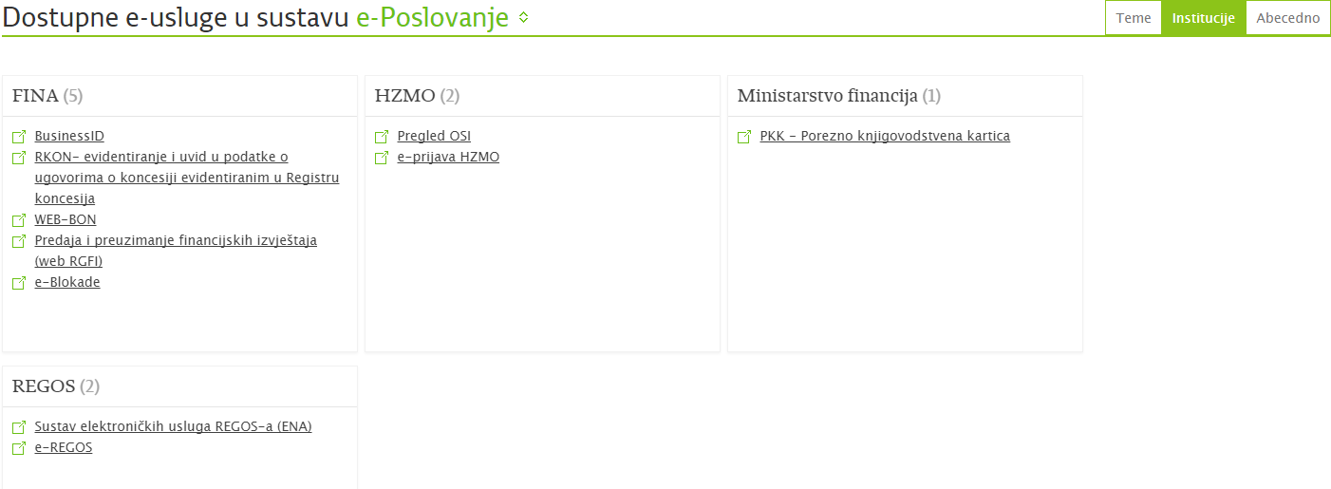
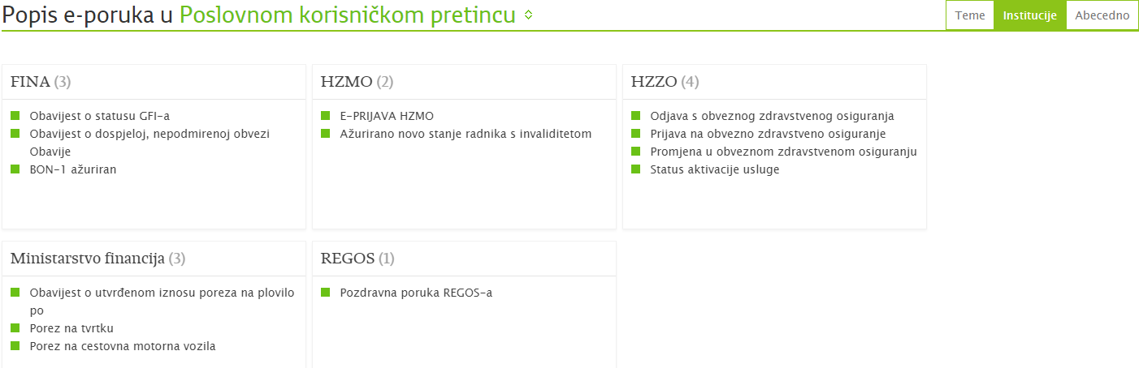
Services and Messages

Slide 24
e-Services
FINA
  BusinessID
  RKON – registering and insight of data on contracts on concessions registered in the Registry on concessions
  Web- Bon creditworthiness
  Submitting and downloading of financial reports (web RGFI)
  e-Blockages
CROATIAN PENSION INSURANCE INSTITUTE
  Overview of disabled people
  e- forms for CPII

Slide 25
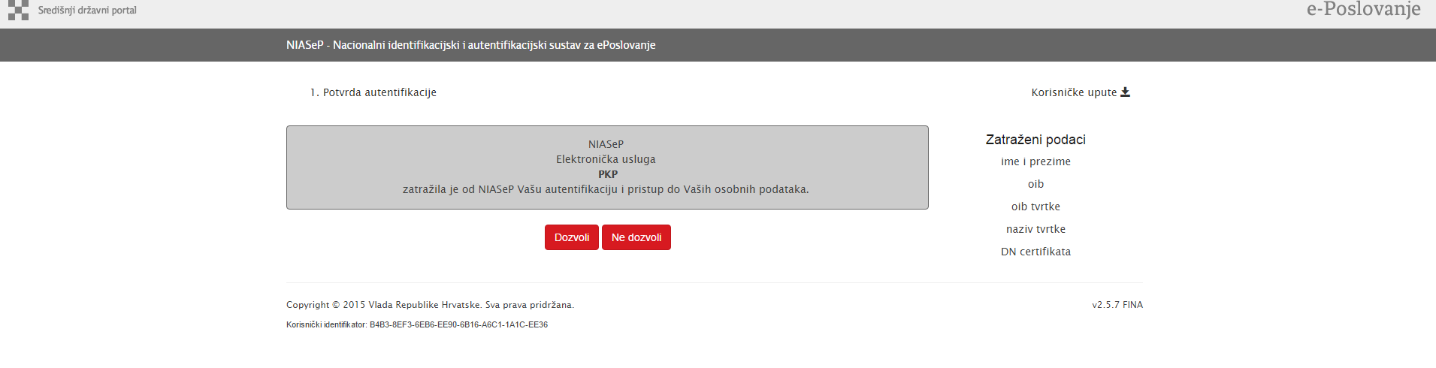
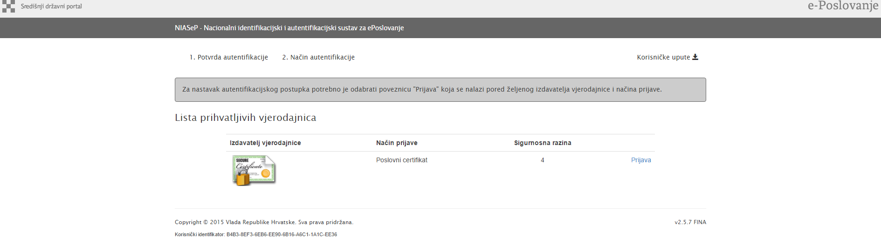
Login

Slide 26
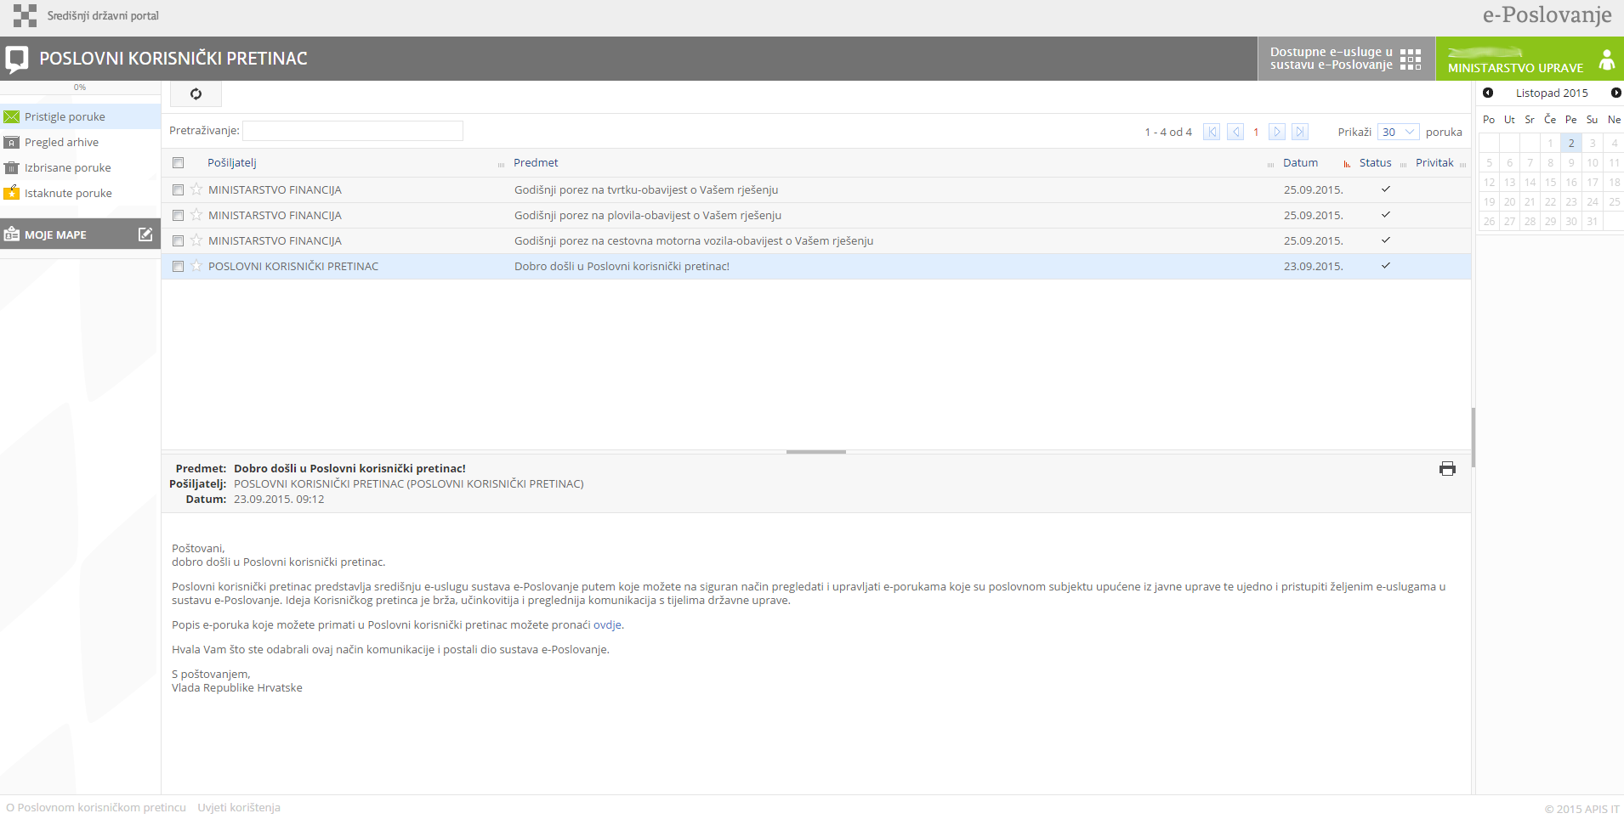
BUSINESS USER MAILBOX
(PKP)

Slide 27
It is just the beginning…
…authorisation, e-babys, e-Business,
cross-border e-services……
Thank you!!
e-mail: llepri@uprava.hr

