Slide 1
Information and Knowledge Management Education and Research at Monash Professor Sue McKemmish

Slide 2
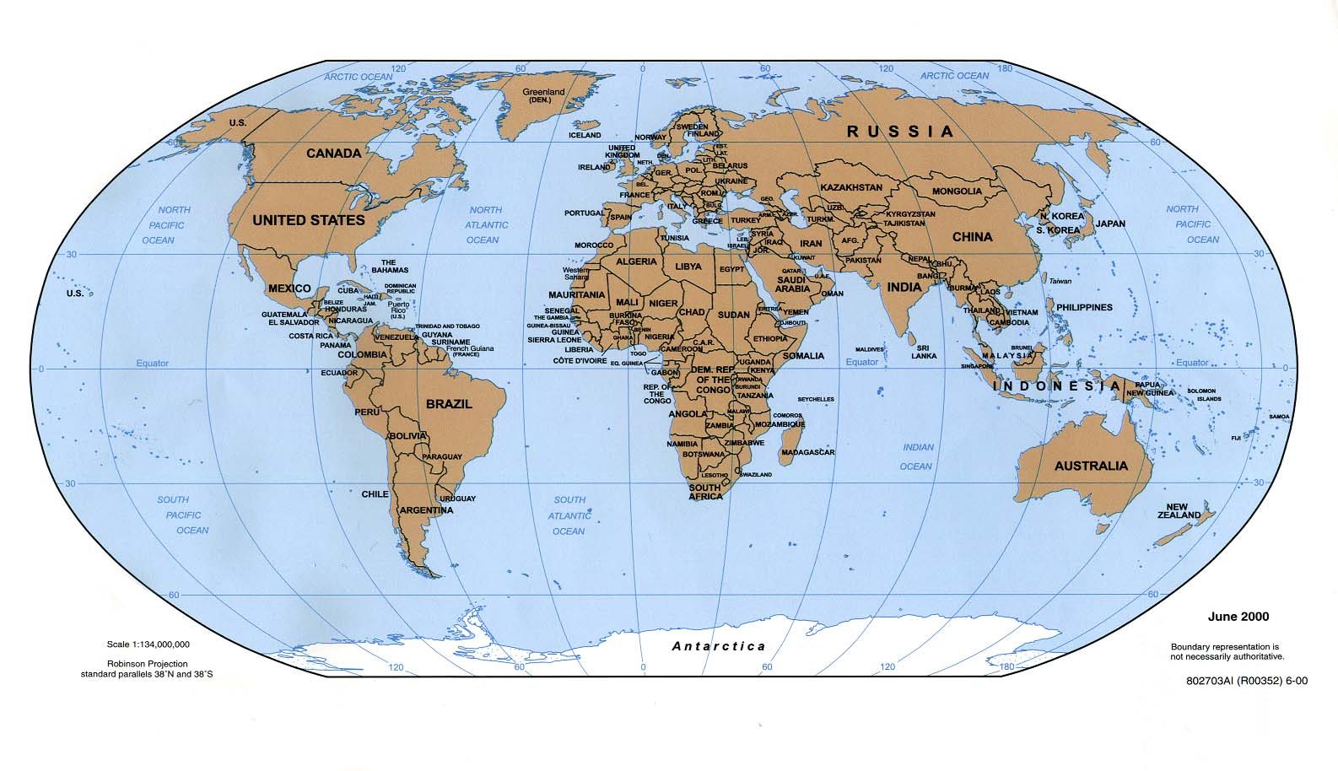
A Global University – Engaging the World
Monash University King’s College Centre
Monash University Prato Centre
Monash University Malaysia
Monash is a member of the Go8, one of Australia’s leading universities
Research-intensive
Established in 1958, it is now Australia’s largest university,
8 campuses
10 faculties
Over 60,000 students
22,000 international students
Monash University Australia
Monash University South Africa

Slide 3
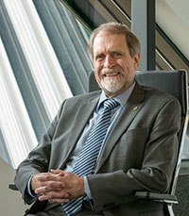
Faculty of Information Technology
The Monash Faculty of Information Technology's mission is to lead global IT research and education. Our goal is to innovate tomorrow's information technology for the benefit of society and to educate our students to become global technology leaders.”
Professor Frieder Seible, Dean of IT
Monash is the only Go8 university with a dedicated IT faculty. It is also ranked one of the top 60 universities in the world by the 2011 QS World University Rankings for Computer Science and Information Systems.
The Faculty of IT is the largest and most diverse Faculty of IT in Australia teaching and researching across the socio-business-technical spectrum from Software Engineering to Business Systems to Information Management and Social Informatics

Slide 4
Master of Business Systems: Structure
FOUNDATION SUBJECTS
Introduction to information technology and systems, e.g. database design, systems design, basic programming, IT governance
STUDY AREA SUBJECTS
Business Information Systems
Librarianship and Information Science
Archives and Recordkeeping
INDUSTRY EXPERIENCE
Industry internships, placements and projects
OR
RESEARCH
Research methods subject
Minor research thesis

Slide 5
Master of Business Systems: Study Areas
BUSINESS INFORMATION SYSTEMS & KNOWLEDGE MANAGEMENT
Subjects covered: technologies such as enterprise systems and business intelligence; approaches to technology planning and management including enterprise architecture, project management and information technology governance; and design skills such as conceptual modeling; strategies and processes for managing organisational knowledge and knowledge flows to achieve organisational goals, enhance performance and add value.
LIBRARIANSHIP AND INFORMATION SCIENCE
Subjects covered: analysing information needs; solving information problems; evaluating information sources; organising information; synthesising information into targeted information products; training clients in the use of information products, services and systems.
ARCHIVES AND RECORDKEEPING
Subjects covered: management of current records, including recordkeeping system design and implementation; recordkeeping standards, policies, process and tools; evaluating and selecting recordkeeping technologies; the role of recordkeeping and archiving in society and organisations; appraisal and disposal; recordkeeping and archival metadata; access and use of records and archives.

Slide 6
Subjects Accredited by Australian Society of Archivists and Records and Information Professionals Australasia
FIT9003 Database systems design
FIT5086 Information and knowledge management principles
FIT5087 Archival systems
FIT5088 Information and knowledge management systems
FIT5090 Social informatics
FIT5102 IT strategy and governance
FIT5104 Professional practice
FIT5107 Managing business records

Slide 7
Managing Business Records
Managing the creation, storage, recall and dissemination of business records within organisation-wide frameworks
Specifying socio-legal and business requirements for evidence
Specifying recordkeeping requirements
Designing and implementing recordkeeping policies, strategies and systems in accordance with industry and professional standards, including the International Standards for records management ISO 30300, ISO15489, ISO23081 etc.
Evaluating, selecting, implementing and using EDRMS and other recordkeeping technologies
Using recordkeeping business analysis tools (workflow, risk management, identification of vital records, functional analysis)
Managing access and use

Slide 8
Archival Systems
Records continuum theory and the records continuum model: postcustodial, postmodern and postcolonial approaches to recordkeeping and archiving
Understanding the fundamental role of recordkeeping and archiving in society - to provide access to recorded information in the form of essential evidence of social and organisational activity for business, commercial, governmental, social, community and cultural purposes.
Functional requirements for evidence and functional analysis as a vital tool in managing records and archives
Appraisal and disposal in the records continuum
Development of metadata schemas and their implementation in recordkeeping and archival systems
Access, accessibility and use
The archival multiverse; community archiving; Indigenous archiving.

Slide 9
Professional Practice
Seminars with guest speakers
Organisational and community contexts in which librarianship, records and archives management, and information management are practiced.
The role of professional associations and networks.
Career planning and professional development.
Professional ethics and reflective practice.
Reseach and education.
Information futures: topical issues relating to professional practice and the information industry, e.g.
Open access, open data and creative commons
Digital and information divides: inclusive practice and community engagement
Fieldwork Placement
Through a fieldwork placement, students gain in-depth understanding of an information workplace.

Slide 10
Managing Business Records: Group Assignment
You are a group of recordkeeping consultants, working with a Victorian government organisation on a project to review and improve their recordkeeping systems to comply with RM standards.
You will produce a report to provide guidance and recommendations on designing and implementing improved recordkeeping systems in the organisation.
You will present a business case to the senior management group to convince them of the need to invest in better recordkeeping.
LEARNING OUTCOMES
Students learn how to:
apply their knowledge and practice their skills in a “real life” setting
work together as a team
use a project management approach
think strategically to address the needs of a particular organisation

Slide 11
Online Blended Learning: Moodle Software and Monash University Lectures Online
On campus and off campus students
All teaching materials online
All lectures and tutorials recorded and available online
Assignments submitted online
Assessment and feedback online
Discussion forums and chat rooms
Subjects managed and administered online

Slide 12
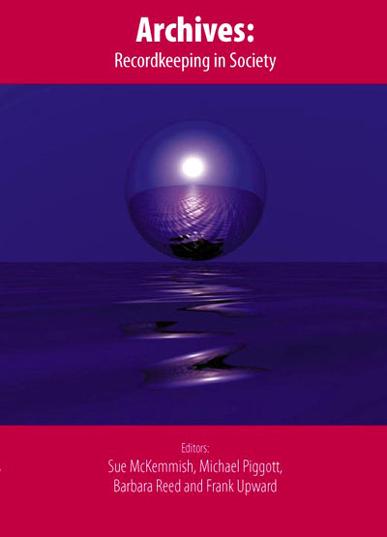
Data Model for ISO23081 RK Metadata Standard
Evidential
Pluralise
Organise
Capture
Create
Identity
Transactional
Published by: Centre for Information Studies, Charles Sturt University, Wagga Wagga, New South Wales, 2005
Records Continuum Model
Recordkeeping Containers

Slide 13
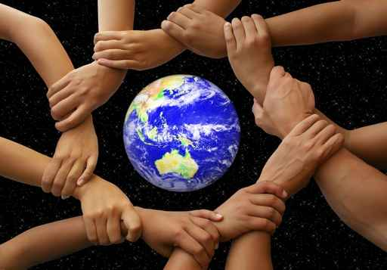
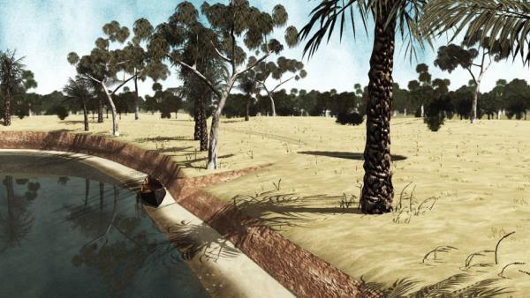
Centre for Organizational and Social Informatics - addressing information, evidence and knowledge needs of society, organisations, communities, social networks and individuals
IT for Resilient Communities & Cultures
Community and Development Informatics
Health Informatics
Information, Memory and Evidence Infrastructure
Indigenous and Community Archiving
3D Animation & Visualisation of Cultural Heritage
Partnerships
Communities, Not-for-Profit Organisations, Cultural Heritage Institutions, Government Agencies, Health Institutions, Consultancy Companies, Professional Associations, Universities and Academic Networks
Funding sources
Australian Research Council, Health and Government funds, Philanthropic funds
COSI Flagship

Slide 14
Human rights
Social justice
Social inclusion
Resilient cultures
Sustainable communities

Slide 15
Accessible information
Community knowledge production
Information and evidence for action, advocacy, activism, autonomy, self- determination
Connectivity
Innovative use of technologies
Identity, memory and accountability infrastructure
Participatory research in partnership with communities

Slide 16
Research
How can community and cultural informatics enable the development of strong, healthy and resilient communities, promote and support social inclusion, and bridge the digital and information divides?
What role do information technologies play in community empowerment and disempowerment, social inclusion and exclusion, and in creating or bridging digital and information divides in an increasingly complex society?

Slide 17
Education
What community and cultural informatics curriculum and modes of delivery meet community and stakeholder needs relating to building resilient communities and preserving cultural heritage?
What kind of education infrastructures do we need to support shared curriculum development and delivery?
How can we build partnerships between educators, communities and stakeholders to develop and deliver
relevant community and cultural informatics
curriculum in academic and community settings?

Slide 18
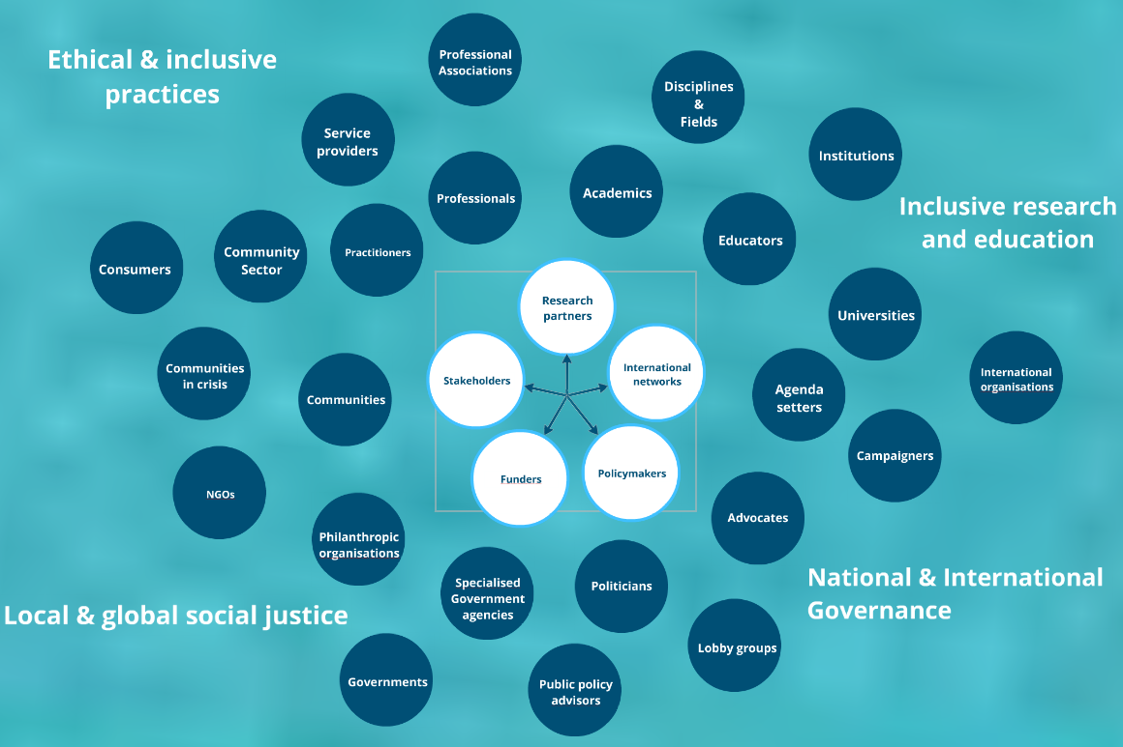
Collaborative networks

Slide 19
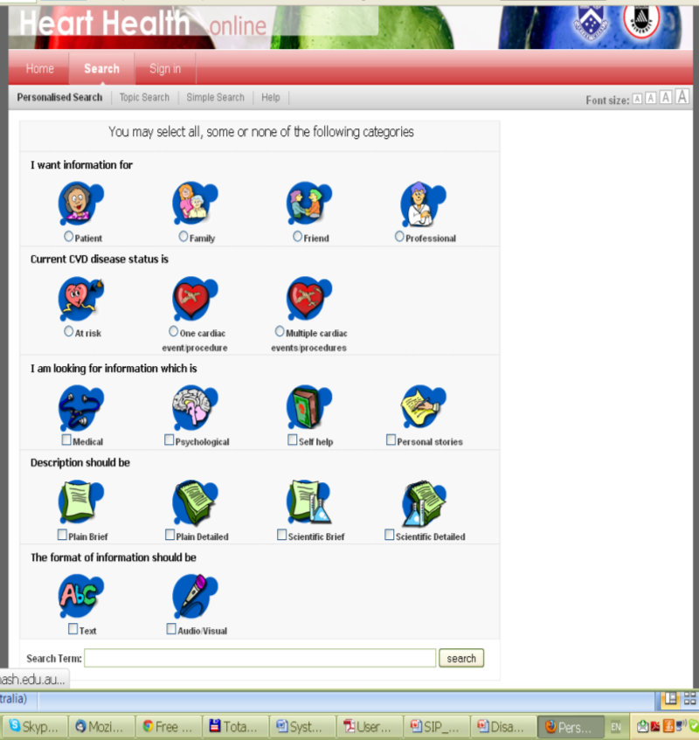
Smart Health Information Portals
IT for Resilient Communities Research Flagship
Enabling strong, healthy, resilient communities
Promoting social justice
Bridging the digital and information divides
Sustaining resilient cultures

Slide 20
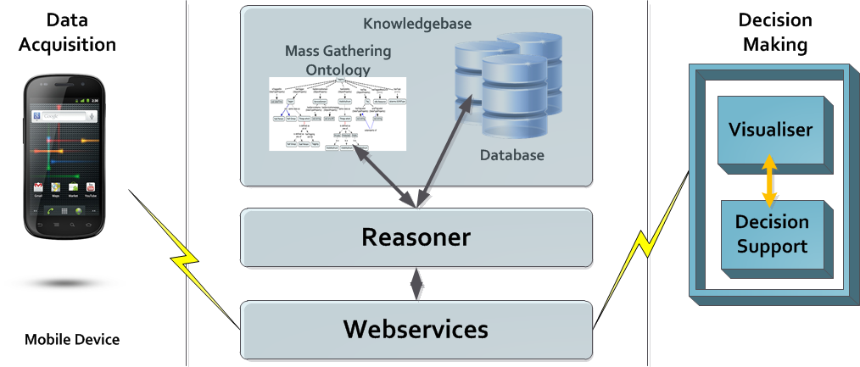
Frada Burstein’s team is developing situation-aware health monitoring and smart information portals to provide timely, customised and quality information to health consumers to support decision making and better health outcomes.
Kirsten Ellis’ team is working with Deaf Children Australia, Vicdeaf and Microsoft on a personalised Auslan tutor to teach deaf children's parents sign language. Kinect with Signs will develop skills that are vital to communication in the family home.

Slide 21
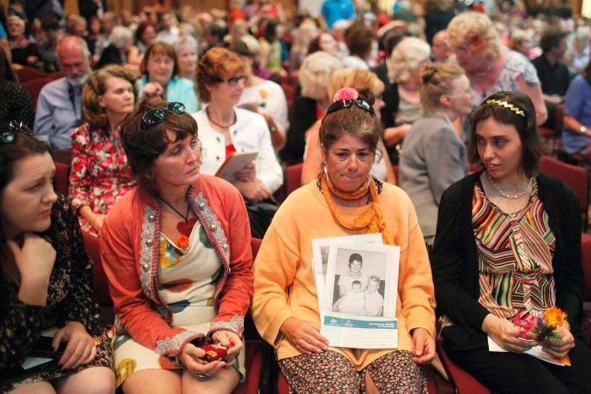
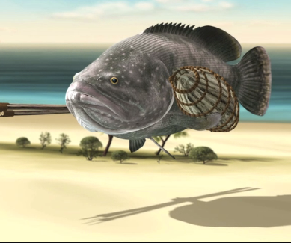
Sue McKemmish and her team are working with Australian and international academic partners and communities in crisis (Stolen Generations, Child Migrants, Forgotten Australians, Kidnapped Babies, Asylum Seekers) who need access to archival evidence for identity, family link-up, memory, compensation and redress purposes
Tom Chandler’s team is working with the Monash Indigenous Centre and Australian Indigenous elders to help them recover language and preserve and share their knowledge and culture using 3D animation. Trans-generational knowledge transmission is a major goal.

Slide 22
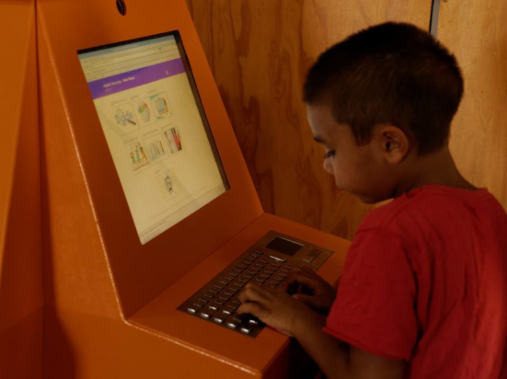
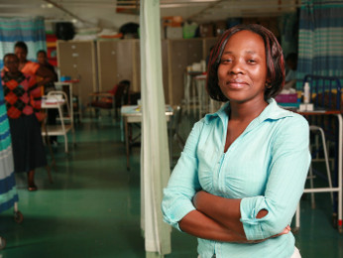
Julie Fisher’s team is working with the Wunan Foundation in Kununurra to evaluate the impact of digital technology and the internet in remote Indigenous communities, particularly in relation to the education of children
Photograph provided by Wunan Foundation, Kununarra, WA
Larry Stillman’s team is collaborating with Oxfam and using Development Informatics to study the role of ICT in ensuring community voices are well represented in the decision making processes of aid organisations

Slide 23
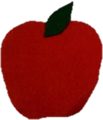
Education Flagship
Shared Curriculum Development
Community Informatics
IKM in Communities
Community Archives
Indigenous IKM
Community Health Informatics
Cultural Informatics
Technologies for Virtual Heritage
3D Modelling Foundations
Information Visualisation
Managing Multimedia Object Archives
Community & Stakeholder Workshops
Learning Pathways
Shared Delivery of Units and Modules in University Programs

