Slide 1
Bringing Circus History into the Digital World
Maureen Brunsdale,
Special Collections & Rare Books Librarian
Illinois State University’s Milner Library

Slide 2
Four Collections
Rare & Fine Books
Abraham Lincoln Collection of Harold K. Sage
Children’s Literature & Historical Textbook Collection
Circus & Allied Arts Collection

Slide 3
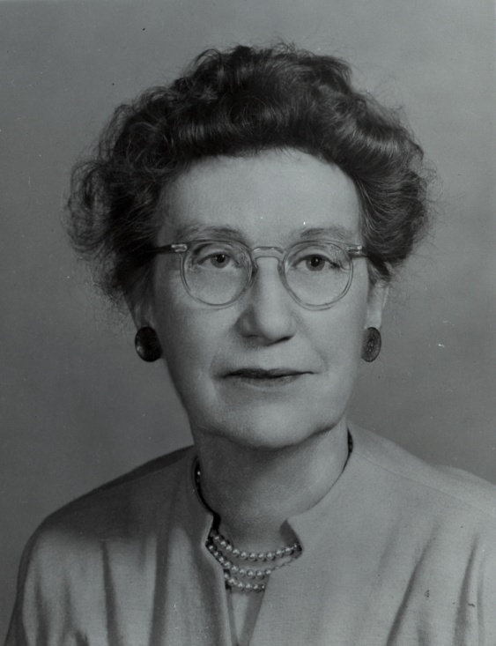
Circus & Allied Arts Collection
Started in the 1950s
by Eleanor Welch…

Slide 4
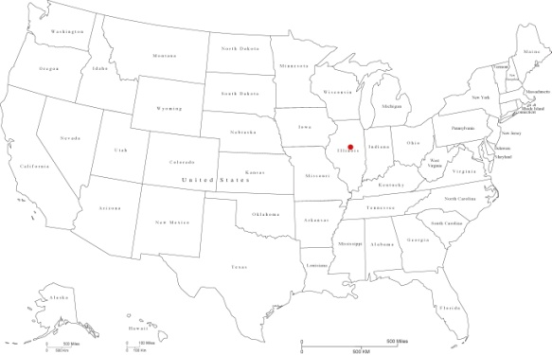
Why Bloomington?
Circus relationship started in the 1870s
Centrally located in the United States
Ease of transportation (rail)
Less expensive than Chicago or St. Louis
Wonderful practice facilities in the community
Came to be known as “trapeze capital of the world”

Slide 5
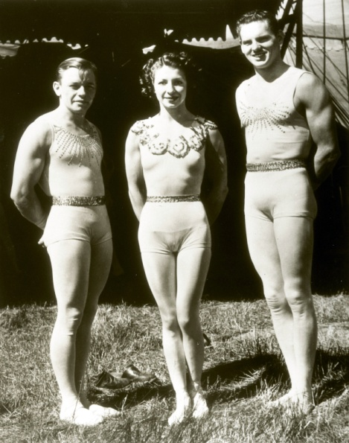
Home of Circus Stars

Slide 6
Stars Who called Bloomington “Home”

Slide 7
Collection now
Over 8000 books (oldest dated 1521)
Ledgers, cashbooks, contracts, correspondence (Ringling Archive)
Images -
Photographs
Negatives
Kodachrome slides

Slide 8
How to Showcase them?
Chose ContentDM as the platform in the Summer of 2010
*http://digital.library.illinoisstate.edu/cdm/landingpage/collection/circus

Slide 9
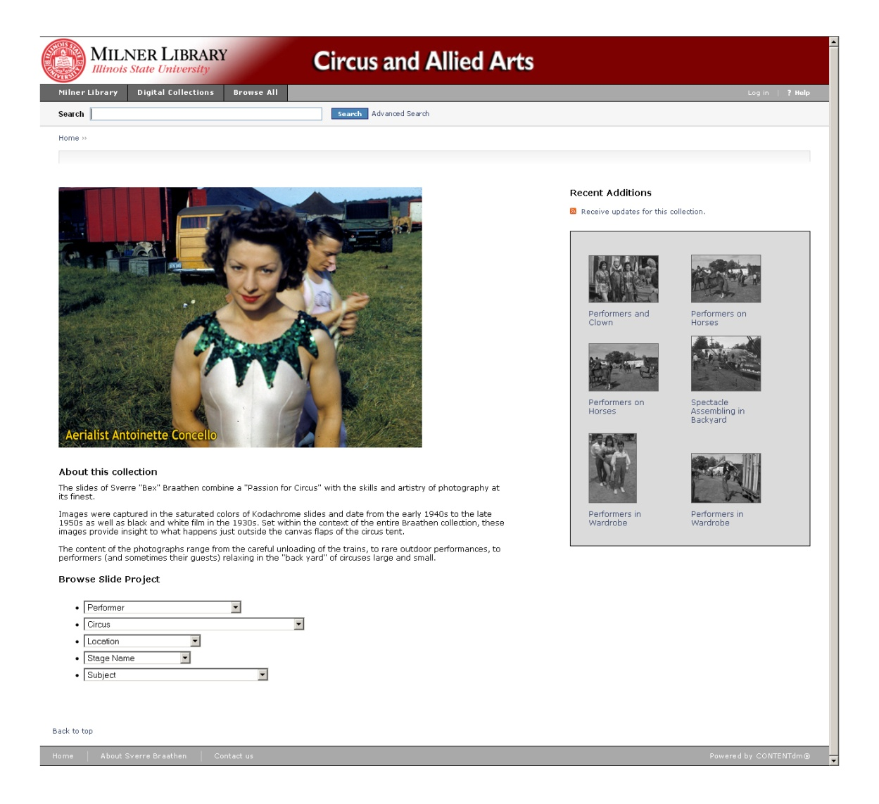

Slide 10
Browse Options

Slide 11
A Record

Slide 12
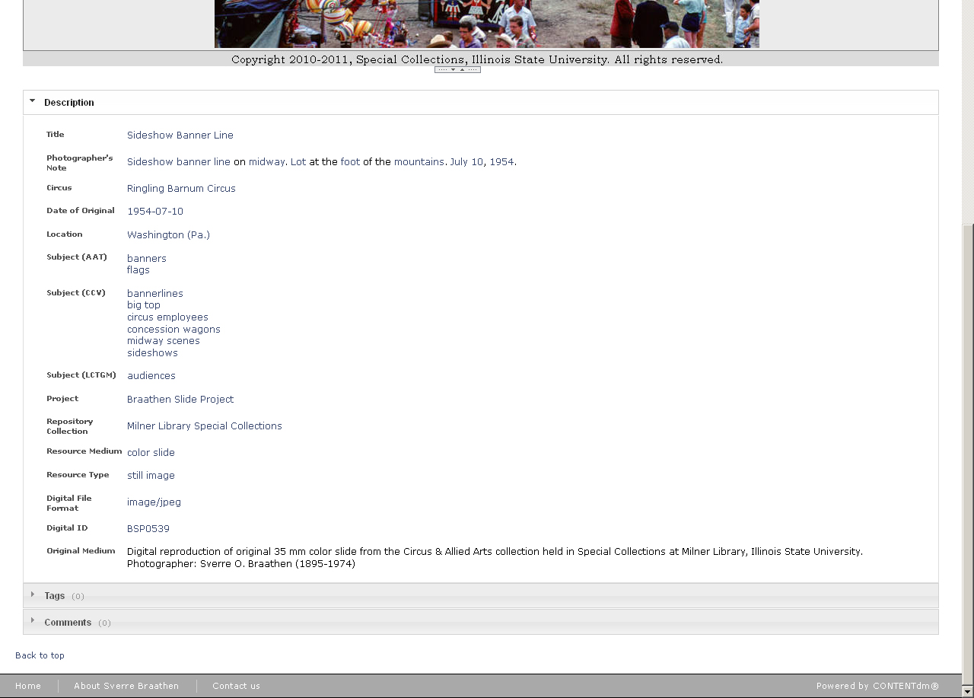

Slide 13
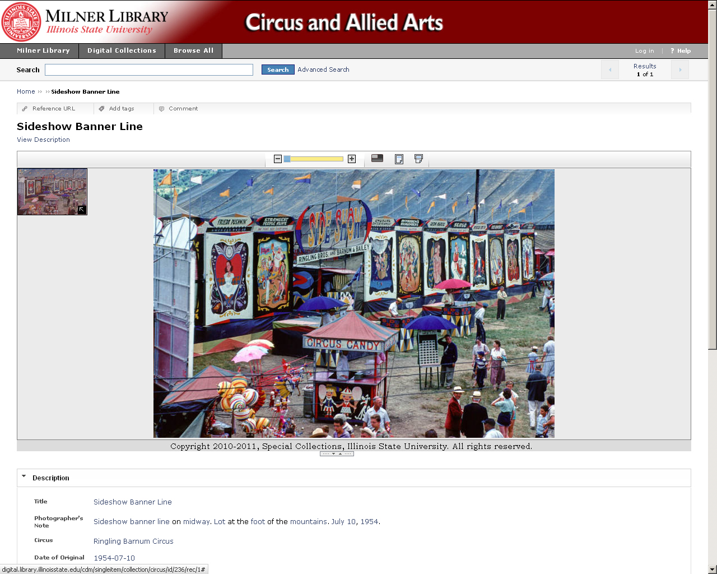

Slide 14
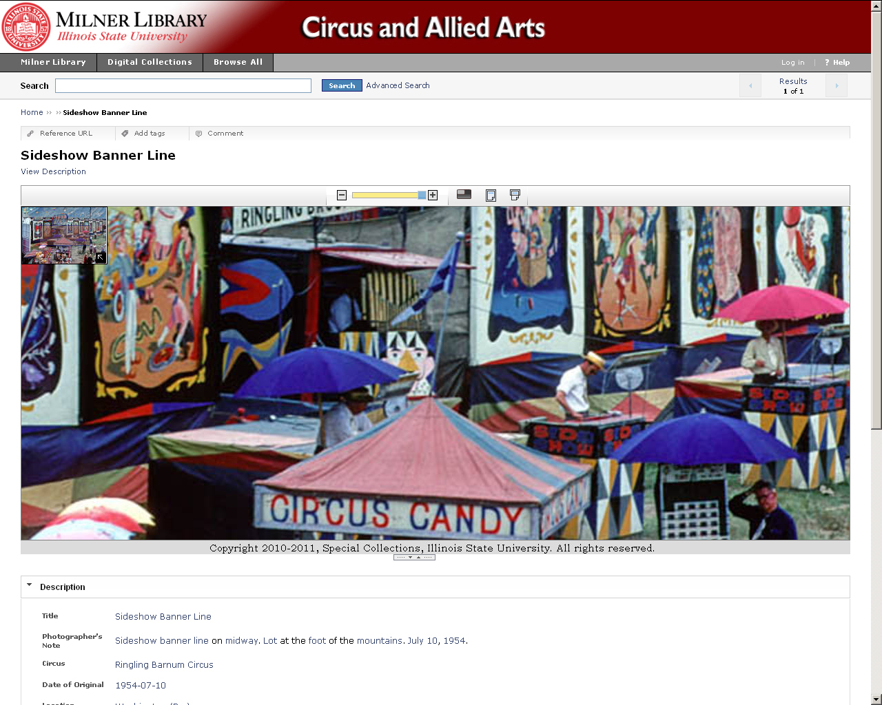

Slide 15
Additional Benefits
Digital Storage
Customizable Search Functions
Sharing on Social Media sites
By partnering with Atlas Systems,
Users can request and pay for reproductions!

Slide 17
The Wisdom of Welch

Slide 18
May all your daYS
… be circus days!

