Slide 1
Crowdsourcing digital cultural heritage
Goran Zlodi, Tomislav Ivanjko
Faculty of Humanities and Social Sciences, Zagreb University
INFuture2013
Zagreb, 6-8 November 2013

Slide 2
Overview
discussion on crowdsourcing and related terminology
differentiation between related terms
discussing framework of crowdsourcing use in cultural heritage sector
benefits for heritage institutions and benefits for users
still opened questions

Slide 3
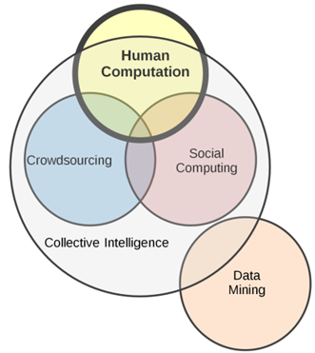
Field of Collective intelligence and related terms
Field of Collective intelligence:
Human computation
Social computing
Crowdsourcing
All depend on group of
participants!
(Bederson and Quinn, 2011.)

Slide 4
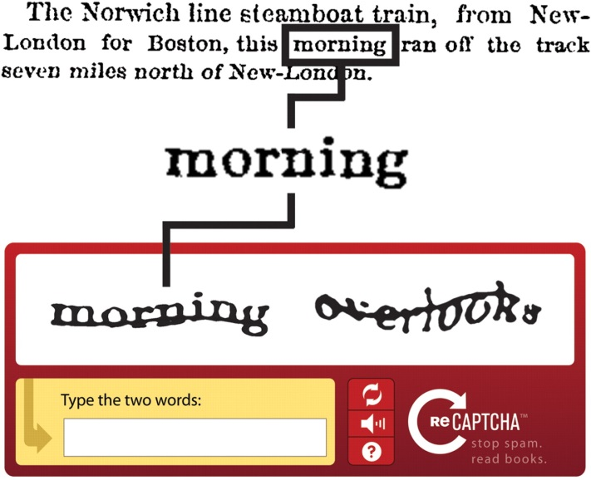
Human Computation
“…a paradigm for utilizing human processing power to solve problems that computers cannot yet solve.” (von Ahn, 2005)
ReCAPTHCHA:
- prevent access to Web sites by automated programs and at the same time improves the process of digitizing books
Notes:
Pprevent access to Web sites by automated programs – and at the same time reCAPTCHA improves the process of digitizing books by sending words that cannot be read by computers to the Web in the form of CAPTCHA.
FYI: With the assistance of reCAPTCHA, the entire New York Times archive from the 1850′s – 1980′s have been completely transcribed in less than 12 months.

Slide 5
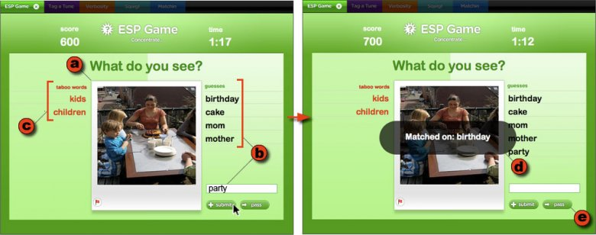
Human Computation
ESP Game: reframe the image labeling process as a game (von Ahn, 2004)
Notes:
What the ESP Game does is to reframe the image labeling process as a game,

Slide 6
Difference between human computation and the social computing
Human computation and social computing as opposing polls of crowdsourcing:
 | Human Computation (e.g. ESP Game) | Social Computing (e.g. Wikipedia) (Wisdom of Crowds)
Tools | Sophisticated | Simple
Task Nature | Highly structured | Open ended
Time Commitment | Quick & Discrete | Long & Ongoing
Social Interaction | Minimal | Extensive Community Building
Rules | Technically Implemented | Socially Negotiated
(Owens, 2012)
Notes:
Two poles !!!

Slide 7
The term “crowdsourcing” isn’t really appropriate for cultural heritage domain
“crowd” - projects in the heritage sector mostly don’t involve large and massive crowds
„sourcing” - have very little to do with outsourcing labor
since the term is already in use, there is a need for refinement and distinction when using the term “crowdsourcing”

Slide 8
Nichesourcing?
When the is a need for specific knowledge on the subject matter, often the “public” is not the right target if the quality of metadata gathered is vital. One approach can be found in the idea of “nichesourcing”.
“Nichesourcing is specific type of crowdsourcing where complex tasks are distributed amongst a small crowd of amateur experts ... rather than the “faceless” crowd”. (de Boer et al., 2012)

Slide 9
Key remarks on use of „crowdsourcing” in cultural heritage sector
the field of harnessing collective intelligence in the cultural heritage sector is not only based on the idea to use the public, but to engage them to contribute, collaborate and co-create. (Bonney et al., 2008).
It is not only about getting things done but to communicate the collection to the users by shifting their focus from consuming digital collections to collaborating in its development (e.g. Collection policy).

Slide 10
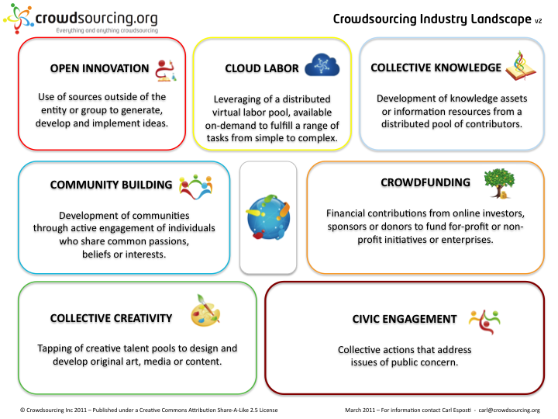
Crowdsourcing taxonomy as a framework for the industry
http://www.crowdsourcing.org/
Notes:
Good starting point

Slide 11
Crowdsourcing taxonomy categorising the field in six different areas ...
crowdfunding – financial contributions from online investors, sponsors or donors
crowd creativity – tapping of creative talent pools to design and develop original art, media or content (e.g. istockphoto.com)
distributed knowledge – development of knowledge assets or information resources from a distributed pool of contributors (e.g. GalaxyZoo, openbuildings.com)

Slide 12
...Crowdsourcing taxonomy categorising the field in six different areas
cloud labour – leveraging of a distributed virtual labour pool available on-demand to fulfil a range of tasks from simple to complex (e.g. AmazonMechanicalTurk)
open innovation – use of sources outside of the entity or group to generate, develop and implement ideas (e.g. challengepost.com)
tools – applications, platforms and tools that support collaboration, communication and sharing among distributed groups of people (e.g. socialvibe.com, bigdoor.com)

Slide 13
Four models based on public participation in cultural institutions
contributory projects - visitors are solicited to provide limited objects, actions, or ideas to an institutionally controlled process
collaborative projects - where visitors are invited to serve as active partners in the creation of institutional projects controlled by the institution
co-creative projects - community members work together with institutional staff members from the beginning to define the project’s goals and to generate the program or exhibit based on community interests
hosted project - iinstitution turns over a portion of its facilities and/or resources to present programs developed and implemented by public groups
(Simon, N., 2010)

Slide 14
Models of participation in crowdsourcing activities ....
tagging – applying unstructured labels to individual objects
debunking - flagging content for review and/or researching and providing corrections
linking - linking objects with other objects, objects to subject authorities, objects to related media or websites;
categorising - applying structured labels to a group of objects, collecting sets of objects or guessing the label for or relationship between presented set of objects

Slide 15
...Models of participation in crowdsourcing activities
stating preferences - choosing between two objects or voting on or 'liking' content
recording a personal story – contextualising details by providing subjective oral histories or eyewitness accounts (gives opportunities for different, parallel or even opposite stories)
creative responses - writing an interesting fake history for a known object or purpose of a mystery objects

Slide 16
Tangible outcomes
Perspective of tangible outcomes, i.e. how can different crowdsourcing types contribute to the working practices and what can different initiatives offer as real outcomes
Crowdsourcing type | Sort definition
Correction and Transcription Task | Inviting users to correct and/or transcribe outputs of digitisation processes.
Contextualisation | Adding contextual knowledge to objects, e.g. by telling stories or writing articles/wiki pages with contextual data.
Complementing Collection | Active pursuit of additional objects to be included in a (Web)exhibit or collection.
Classification | Gathering descriptive metadata related to objects in collection. Social tagging is a well-known example.
Co-curation | Using inspiration/expertise of non-professional curators to create (Web)exhibits.
Crowdfunding | Collective cooperation of people who pool their money and other resources together to support efforts initiated by others.
(Oomen and Arroyo (2011)

Slide 17
Conclusion...
many advantages in implementing crowdsourcing services and projects within cultural heritage sector
added value for institutions is strengthening the relations with end users and getting more precise insight in user’s needs
persons involved in crowdsourcing also find value in contributing to cultural heritage research and enrichment of their cultural identity

Slide 18
...Conclusion
new way of partnership in digital environment it is necessary to continuously improve mechanisms of collaboration to achieve desired level of trustworthiness and quality of added content
new user-generated (meta)data sets!
origin of data will have to be clearly labeled so that user created data is easily differentiated from data created by heritage professionals

